Slide 1
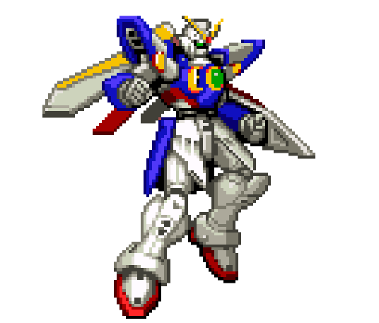
..5 Ps of my..
幸せな生活
21790823 Thianbodee Chutivanichayakul

Slide 2
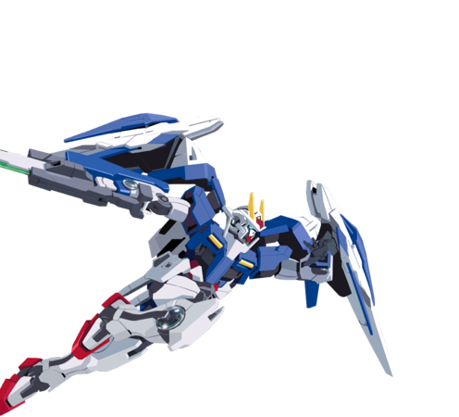
Since, I was young I must say that my life was fulfilled by Gameboy Pocket , PlayStation , Nintendo and any other toys. Moreover, in recently years, I was founded that I am a Gundam and Tamiya Mania.
It was started from watching a series of its Manga (comics), observing its models ,entering all kind of Gundam exhibitions and then making my own Gundam.
There are so many sophisticated steps in order to make a Gundam which include distinguishing, coloring, and assembling all particles. Some larger.. some smaller and yes, some very tiny and hard to deal with. However, I never feel discouraged. It seem like I am getting an obsession with them. Gundam have turned me from “A Lazy guy” to be energetic man. Till now, 20 models of Gundam were created from my own hand but yet I still enjoyed and never getting bored. Therefore, I realized that if we can do something we love. It will make everyday go on happily.
And if we can bring something we love into our work life. It’s a plus+
Moreover, when I walk around the toy shop or game shop time went so fast. I believe that It could be because when you do something you like time will pass very fast. Also when there was an exhibition about game or toy I always join them. Not only that I also sometime join some competition that head on the exhibition as well.
Passion

Slide 3
Passion
Below are some famous exhibitions in Thailand that I love to join. There are many good exhibition that I always joy but this two are very famous in Thailand where I can’t hardly miss. I was start from observer but nowadays I’m one of exhibitor or player.
Gunpla Builders World Cup will heading in Thailand every year. This Exhibition will invite every gundam builder in Thailand to join and show their work. One of the most interesting thing in this exhibition is that the winner will have a chance to join Gunpla Builder World Cup in Japan to exhibit their work too.
As I remember Tamiaya is a car model which I play since I was very young. I still remember how enjoyable my first car run in the track until today.
Tamiya mini 4wd tournament also one of the famous event heading in Thailand every year. This tournament will find 5 best Tamiya mini 4wd player in Thailand to come to join biggest Tamiya mini 4wd cup in Japan each year.

Slide 4
For me, Creativity and Enjoyment could be my passion. I could say that since I was a child I like drawing and painting color on cartoon books. At that time, I remember how enjoyable I am until today. Moreover, after I graduate from high school where I need to choose what bachelor degree I need to choose. It wasn’t hard for me to select the right one because I really know what I want. And finally I choose architecture as my major.
My passion is very clear that what I really like is drawing, painting, making model and designing. In simple word, I could say creativity and designing is the most important passion for me.
Sometime It’s hard to say what do you like exactly and why do you like it. There is no reason. However, it wasn’t hard to explain what is your passion.
Passion make who you are from the inside. No matter when you are or what you do you can find you passion inside you. It is very important to find you passion so you can plan your future.
Everyone have different passion but the most important thing is we need to find our passion to be happy in life.
Passion

Slide 5
Alternatives that were rejected
Purpose
 | Get back to work for the same company This option will bring back my old life that have less time to fulfil my passion
 | I would like to be a part of Garena Thailand or SEA Group Working for one of the big company in game industry such as Garena will bring me closer to my passion. However, at this option it will be more on business perspective
 | Working for gaming exhibition center Working for exhibition center and arrange exhibit program about toys or games could benefit my passion. This option will also fulfil my passion and my creativity. However, the exhibition wasn’t ehibit a lot in Thailand. Maybe 2-3 time a years

Slide 6
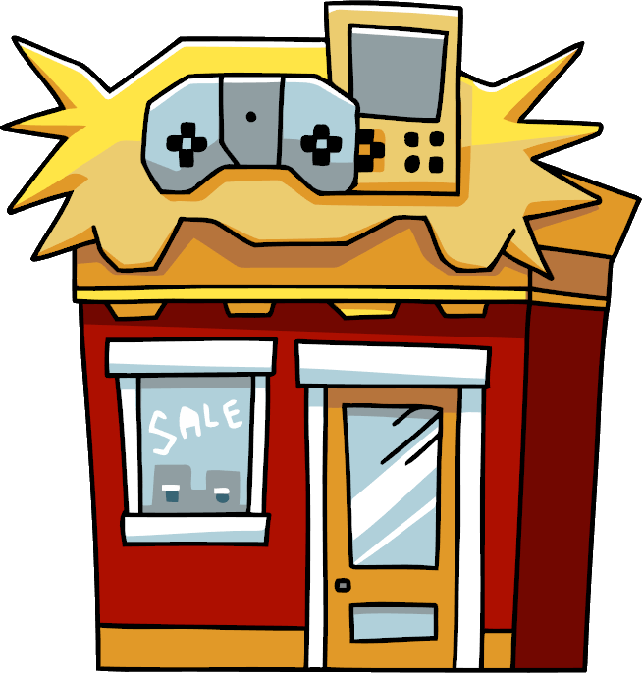
“I would like to own my shop providing all kind of Games and Toys from over the world”
Ppose
5 years | Entering the market in Thailand starting from Bangkok and expanding to any other provinces and Being well-known among Thai people. Owning a shop could be complete 100% fulfil my passion. I can work with what I like freely or can do anything as I wish to.
10 years | Entering ASEAN Market could be my next step. As my passion is about creativity and designing I is very important to see what people like or people are in different culture. I always believe that creativity never stop so it could be very important to expand the market and open new perspective on my passion.
15 years | Being a pioneer on Games and Toys To be success for in this industry especially in Thailand is to be a sole distributor. Within 15 yeas I believe I could gain trust from all my supplier and I believe I can request for sole distributor contract. Then I can expand more market and represent as hub in Thailand.

Slide 7
Own a store can be the best alternative to fulfil my passion
Passion is very important to be happy in life. As human being we born to find happiness which mean we need to fulfil our passion as much as we could so we can be happy in life.
Owning a game/toy store can freely open my creativity which is important factor on my passion. Which mean if I am joining other company and working for them it could limited my creativity and it will effect my passion.
It doesn’t mean that I can’t fulfil any of my passion if I choose to work for other company. I believe that I also could fulfil my passion but I could take time to grow inside the company before the time come.
Finally, the best alternative that I will choose is to have my own business and fully open my creativity idea and fulfil my passion to be happy in life. Moreover, I would like to pass my passion to the next generation kid as well.

Slide 8
NEXT MONTH
Specific – Have and gain more knowledge form NUCB
Meaningful – I could be very helpful for me to learn from NUCB cause my background is from architecture which have very little knowledge on business field. Therefore, it is very important to learn how to do business here at NUCB.
Action Oriented – Study and try to understand more on class could help to understand more class. Case study can help to have better perspective on business point of view. It is very important to try to understand the case study and try my best to consult from each professor because it believe experience and knowledge from each professor can help me to improve myself.
Realistic – Learning how to do business from NUCB could develop me a lot and I could have some important point of view of how to do business which can link them to my future plan.
Timely – I could take me some time to work but within on month I believe there could be many case to read and many professor which I could learn from them.
NEXT MONTH
Plan

Slide 9
NEXT YEAR
Specific – Start to find more experience on how to manage game/toy store and find more connection.
Meaningful – Graduate from NUCB could improve my knowledge on how to do business. However, to be success on the game/toy business I also need some experiences which I could I can find them by working for a big company first to have more experience to combined them with the knowledge that I learn from NUCB to create new business model.
Action Oriented – Back to Thailand together with my MBA degree from NUCB I believe that I won’t be hard for me to find a job that related to my passion. I need to get to work for a company that can supports my future plan which to establish a games/toy store. I will start working for them until I know it the right time where I have enough ability to start my own business.
Realistic – To find more experience on how to manage game/toy store from a big company in Thailand wasn’t hard because there are many company that working on this field which mean I have many opportunity to work for them and gain more experience.
Timely – With my background and my passion I believe I won’t cause me too much time gain more experience and start my own company.
NEXT YEAR
Plan

Slide 10
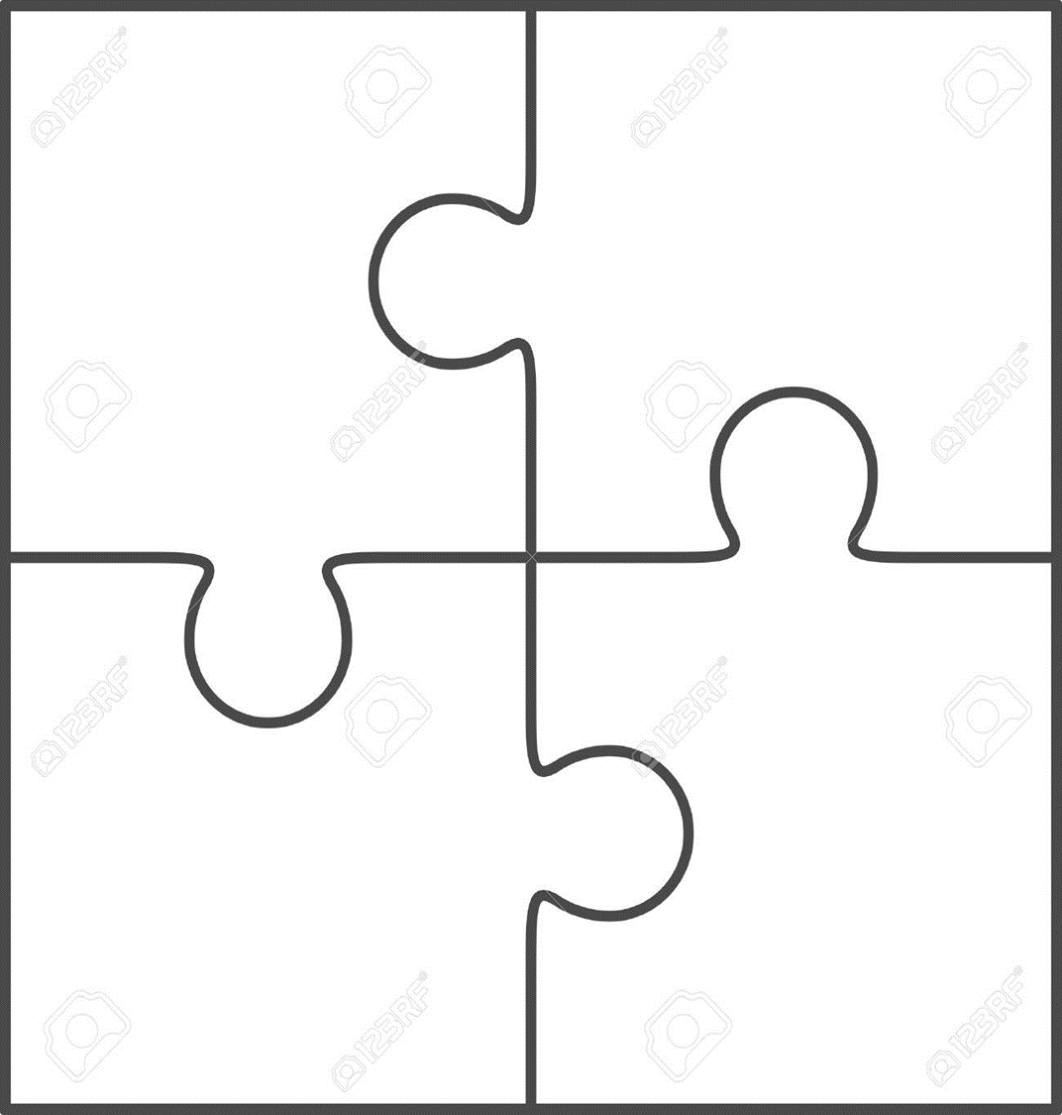
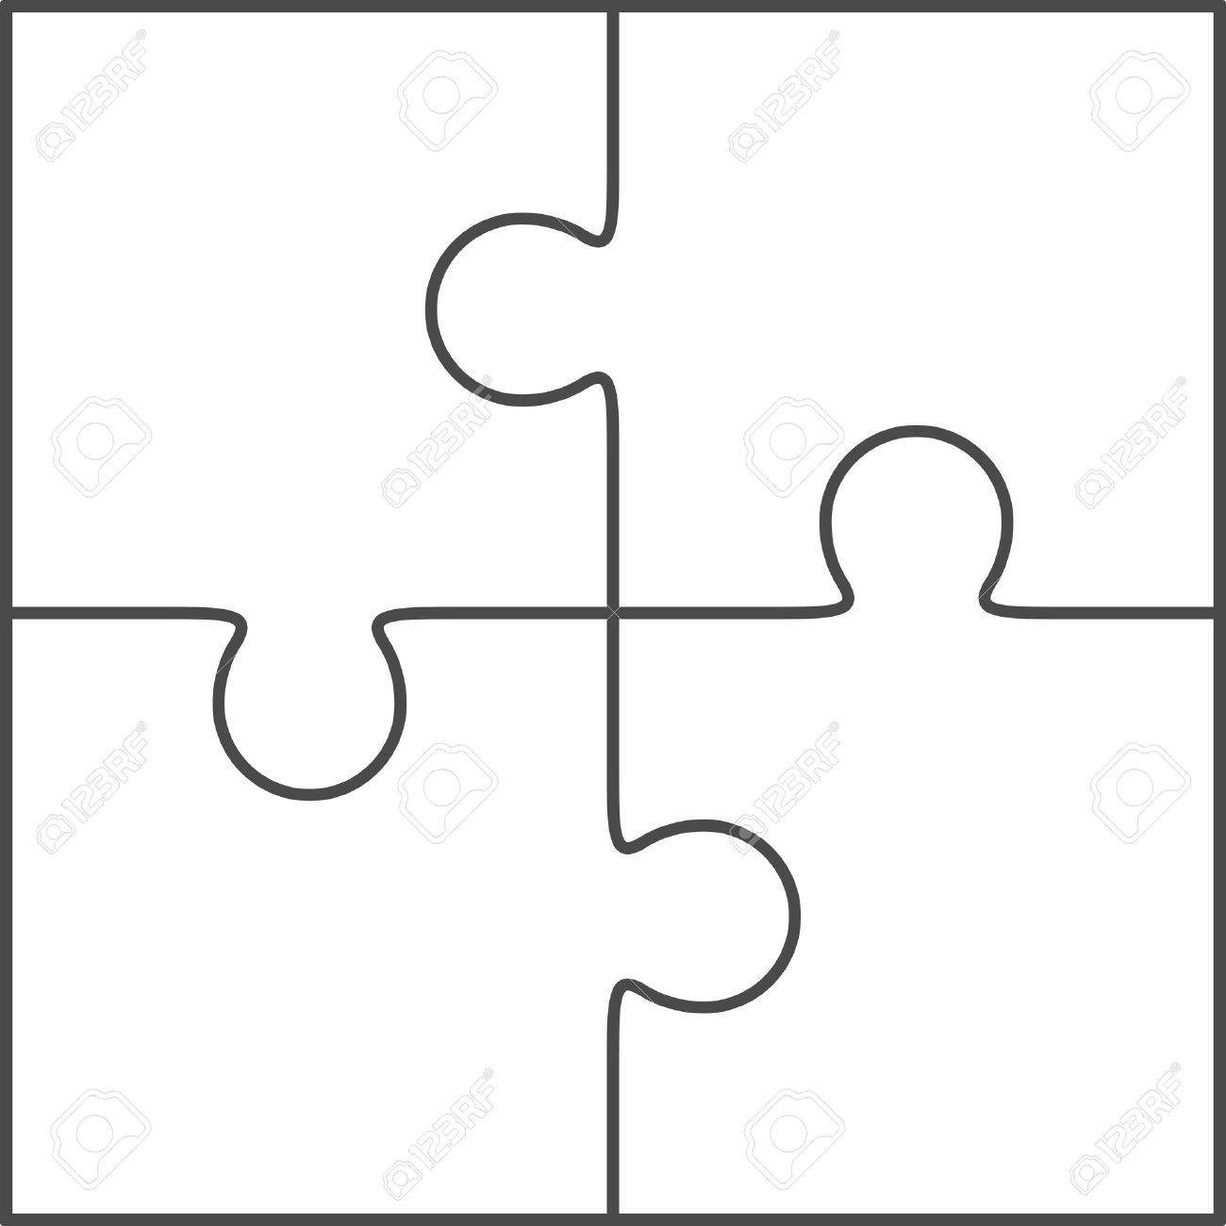
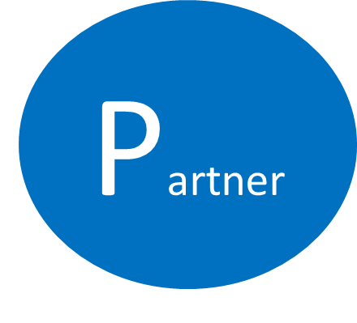
My Professor from NUCB
Who provide the business knowledge.
My Parent
For financial support
(in the beginning)
My Business Partner ie. BANDAI ,TAMIYA, SONY, MICROSOFT and etc
My friends from Gamer’s society

Slide 11
Sustainable Benefits
Partner
It could be impossible to be success if we don’t have any partner. However, to create a sustain partner benefit should be on both side.
In this case to establish game/toy store most of the products that provide in the store will be import from outside Thailand which mean most of my partner will be located around the world.
As I will try to do marketing to promote my store to be well-known around Thailand to strengthen sale channel. Therefore, I could help my partner by helping to develop their sale channel in Thailand. The bigger sale channel I can make the more benefit we can get.
In simple word I could say me and my partner will getting strong together by helping each other. I will help them by sale channel and they will help me by support reasonable price and high quality products.

Slide 12
Support from partner
Partner
Frankly speaking, Thailand don’t have any local supplier on game or toy. Therefore, the important support from my partner is to have product deliver from my partner.
If is most important key to be success in owning a game or toy is to have a good support from every partner outside Thailand. The support could be such as a better price, marketing tools, develop of new products and delivery process.
When our relationship become stronger together with sale volume growth every year. I believe there could be another step that we could move forward. The next step to be an sole distributor in Thailand. This will be a big expand on volume and improve distribution channel as well.
Moreover, Thailand is also one of the location which good for located and expand around ASEA. This could be count as one of the highest opportunity.

Slide 13
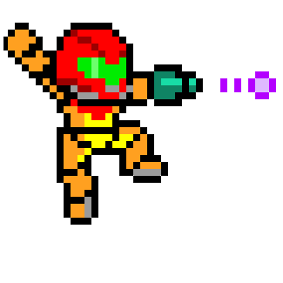
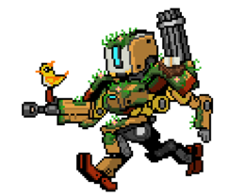
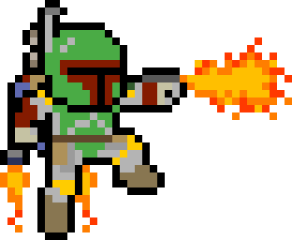
Stay on Track
Persistence
Persistence
As human being is is very important to know you passion and keep them as there are.
For me as I know my passion quite well since when I was a child where I love to drawing then I choose bachelor as architecture which keep me on track. However, I believe that when getting older and start working we will have less free time and this is where most of people has lost their passion.
But not for me, today I still spend most of my free time playing some game and assemble some model to keep my passion. Further more, I still keep on finding new idea and new product which change from what I used to play. When I get older I could see another perspective where I can keep my passion and create a better future.
I could say that to keep passion is very important. I still keep them and enjoy them everyday when I have free time and it always make me happy.

Slide 14
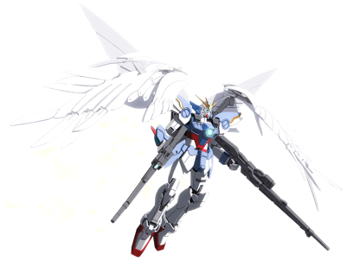
Stay focus
Persistence
When I’m working and I don’t have time to do what I like such as playing some video game, assemble some model, or going to play board game with my old friends some time it could make my lost my passion. When I’m spend most of my time on working and sometime I feel used to them and I start to lost my passion.
However, I feel that if its going like this it could make me lost my passion. Therefore, I need to bring back my passion what I could do first is try to revise my passion by search new innovative game or toy which can bring back my passion from time to time. Moreover, when I have free time I will try to give sometime of my free time to see my collection to maintain my passion.
People can lost their passion from their surrounding however I still believe that the true passion where our happiness is still deep inside everyone. It only waiting for the right time to revise again.

Slide 15
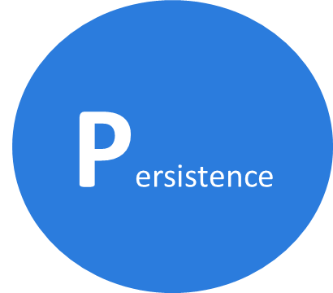
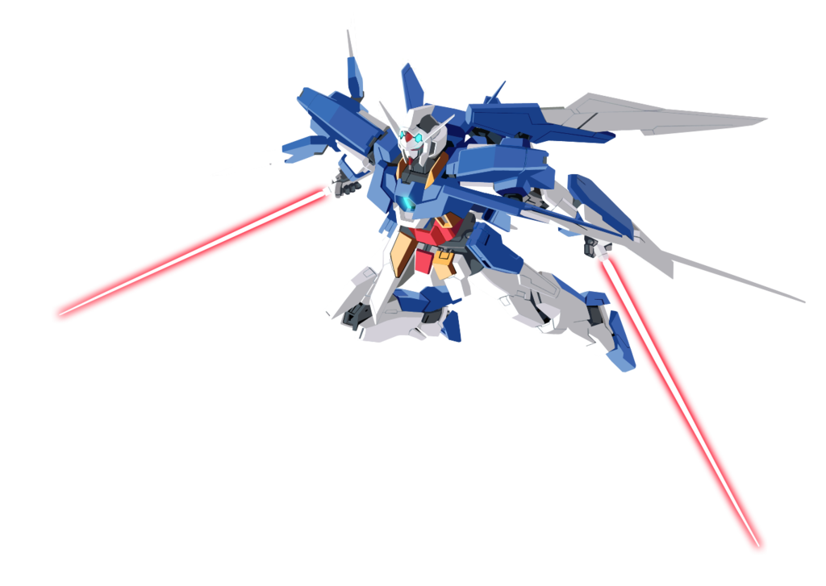
Work Life Balance
I believe that if we attend to do something in long-term, we need to make a balance in our life
Finding inspiration & role model
Measurement
I will reflect my action monthly and also every ending of the year

Slide 16
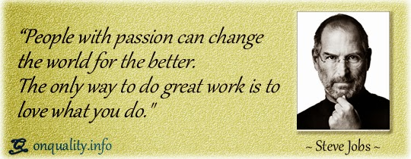
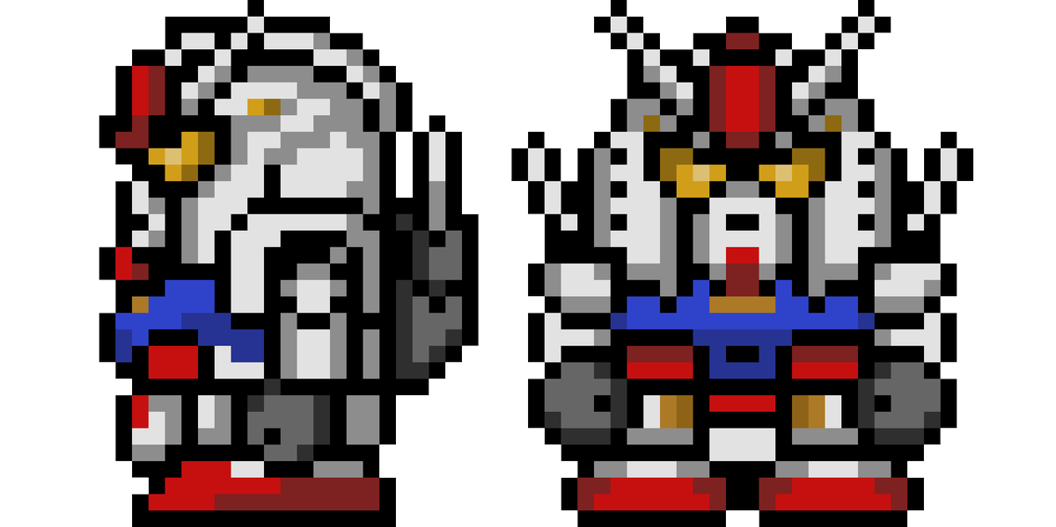
Don’t lose your passion
Persistence
Everyone born to have happiness, therefore, I believe everyone will always try to find their happiness. To me I always go back to do the thing that I love which can lead me to happiness.
Until today I still have the same happiness since I was young. I still playing video games or toys when I have free time. As time go by I don’t have much free time as before but I still fulfil my happiness only by buying those video games or toy even I didn’t play them I still feel happy with what I did.
Due to my passion is never change and I still find the way to fulfil my passion until today. I could say that when I have any opportunity to fulfil my passion I will not lose my chance. It still be a long way in the future but the passion that I have today will make me who I am and achieve my goal.
By doing something that I like, it will make the greater outcome and no matter what I do if it was the thing I love it will make a happy life which everyone is dreaming about.
Every Week
Every Year
Online checking new and innovation on video games and game update
Join and experience any exhibition about video games and toy when available to inspire my passion
Every Month
Find time to assemble any toys or playing some video game

