Slide 1
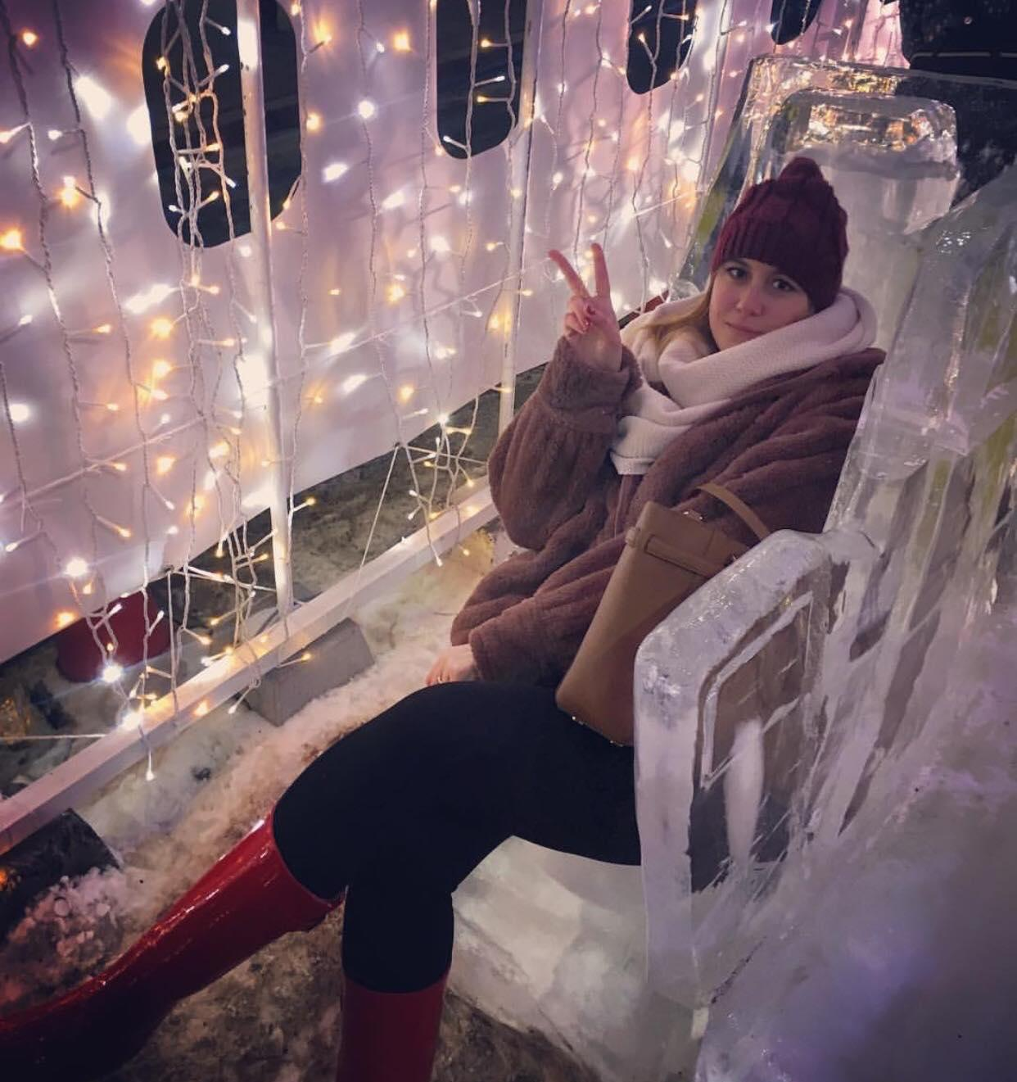
Breaking Barriers to Reach for the stars
Nadia Soussi
21790834

Slide 2




Background
What I wanted/ thought would make me happy:
- Growing up, I wanted to be in the senior management team of a multinational company. It took me three trials, working and interning at companies such as Google, The Coca-Cola Company, and finally Microsoft to confirm the strong feeling that I had everytime that I was not where I was supposed to be, not doing anything of meaning to me. I was working for somebody else’s dreams, an employee among many others, a number on a list. I knew there was more to life than doing the 9 to 5 type of job, and I was determined to turn the situation around, not follow the mold, and break free.
- I had previously worked for an non profit in the U.S. and represented Tunisia at the United Nations Headquarters. I knew that I wanted to help others, that feeling never betrayed me, but doing these things didn’t bring me any peace of mind. In a lot of ways it was serving people and non profits’ personal agendas more than anything else.

Slide 3
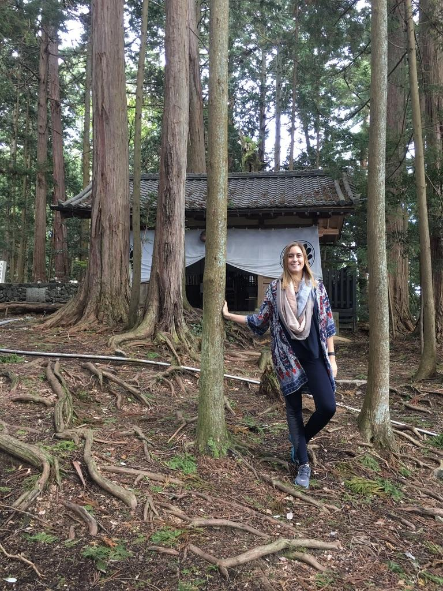
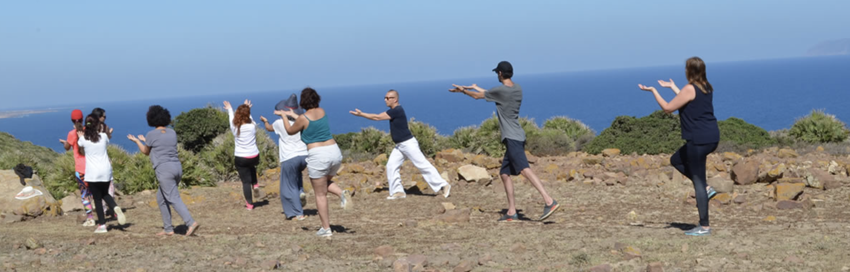
Passion
- Pursuing my spiritual awakening: it is a journey that I have embarked on 3 years ago and that has completely shifted my life. It has put in perspective the reason of our existence and helped me remember that we are spiritual beings on this planet to have a human experience. Spirituality is a centric part of my life and what defines my way of living. The very first thing I do every morning to maintain my energy and focus is called “priming”, it is a technique developed by life coach and entrepreneur, Tony Robbins. It involves a forceful breathing exercise and visualization that lasts for a minimum of 10 minutes.
At Mount Kurama, the birthplace of Reiki
- I also try to meditate at least 3 times a week, live in the present moment, think positively to attract positive energy, and stay in a state of gratitude as much as I can. Whatever you seek is seeking you, I believe with a strong faith, and execution, you can manifest whatever you want in life.
Practicing Qigong

Slide 4
Passion
- Solo travelling the world: In my family my eagerness to travel is not really well understood. Coming from a conservative background with a strict family, I had to work a lot harder to prove that I was responsible enough to be able to travel on my own and find the means to be able to afford my adventures. Most of the internships I have taken or study programs I have been on (still now in Japan) have been solely for the reason of discovering and living in new countries. Being a solo traveler is an amazing thing, not only do I have the chance to meet some great friends on the way but I also meet myself. I love the peace, speaking my future into existence, reliving the good I have met in others. Some people are scared to be alone, but you really do have to be your own best friend. You can’t run to the edge of the earth and expect all your troubles to go away, because no matter how far you go, there you still are.

Slide 5
Passion
- Being my own boss: I have never been good at following orders. I wasn’t disobedient or at least not all the time, but I always have a tendency to question everything, look right when everybody is looking left, sometimes observe more than speak, those are the moments when I learn the most. In that sense it was really hard for me to follow the process of proving myself to others, going the extra mile to be liked by my boss to prove that I was very competent in my job never sat well with me. I learned that everybody has a boss and seeing all that chain of command in front of my eyes made it all the more unbearable. I love working on my own projects, do something I believe in that helps me make a dent in the universe. When I work on something of my own, I feel proud of myself and that gets me excited to wake up every morning and stay up late at night. I have never been happier than when I was working on something I created.

Slide 6
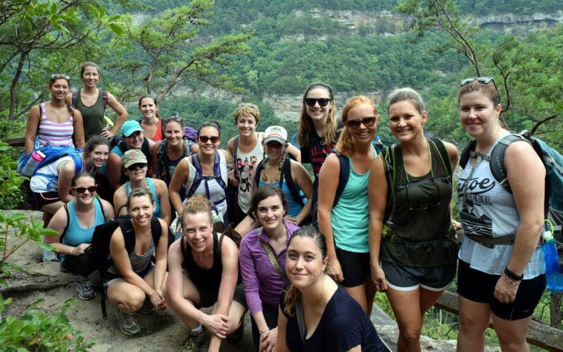
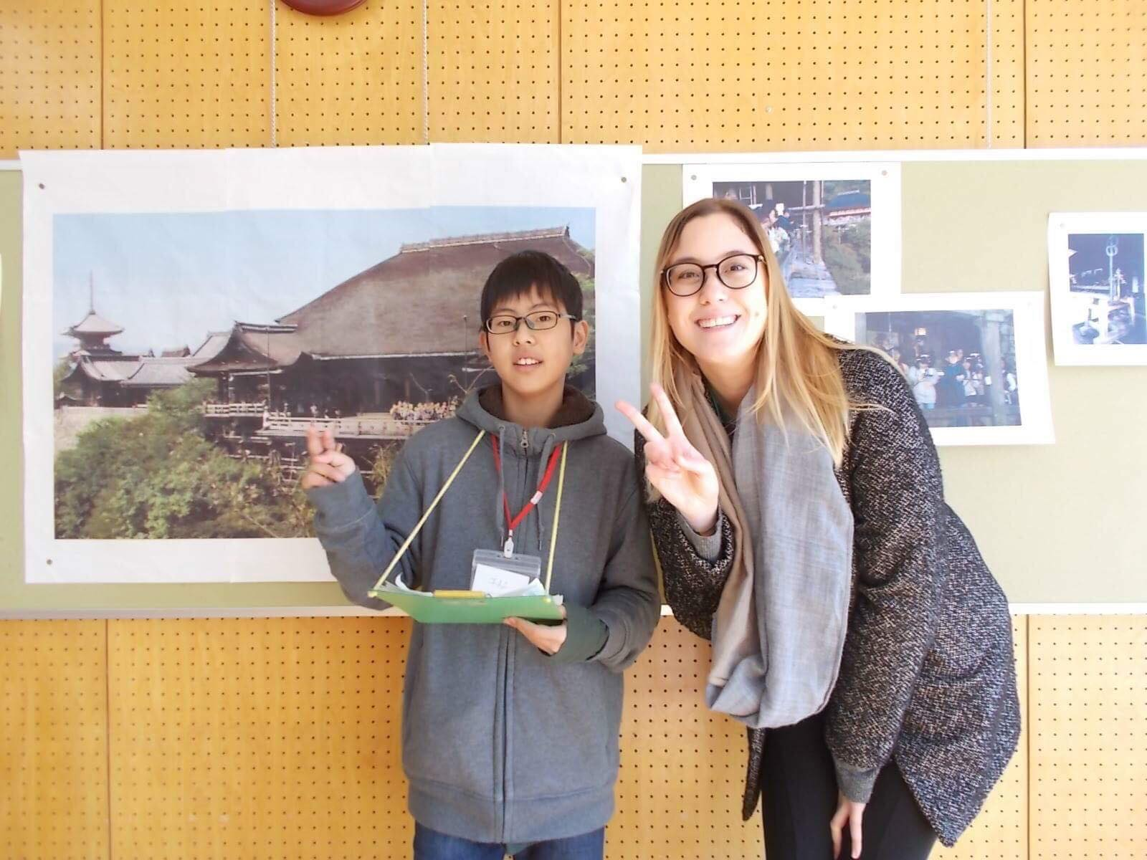
Passion
- Connecting with people: anybody who knows me knows that I hate small talks, be it in networking sessions or wherever I am. You will always see me talking to everybody and being the first to reach out. No matter who we are, we are so different but so similar at the same time in the smallest things, and human behaviors. Independently of our countries of origin, religion, traditions or cultures, we are all the same and planet earth is our home. In that sense I love meeting people and having long hours of talk sometimes even if I won’t be seeing them again. I genuinely want to know more about every person I meet that I find interesting. I believe that the effect you have on people is the greatest currency there is. This world fascinates me mostly due to the amazing people that live in it.

Slide 7

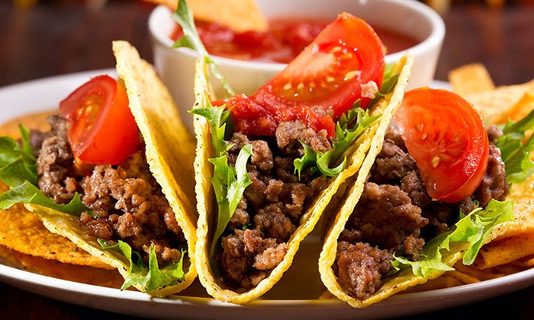
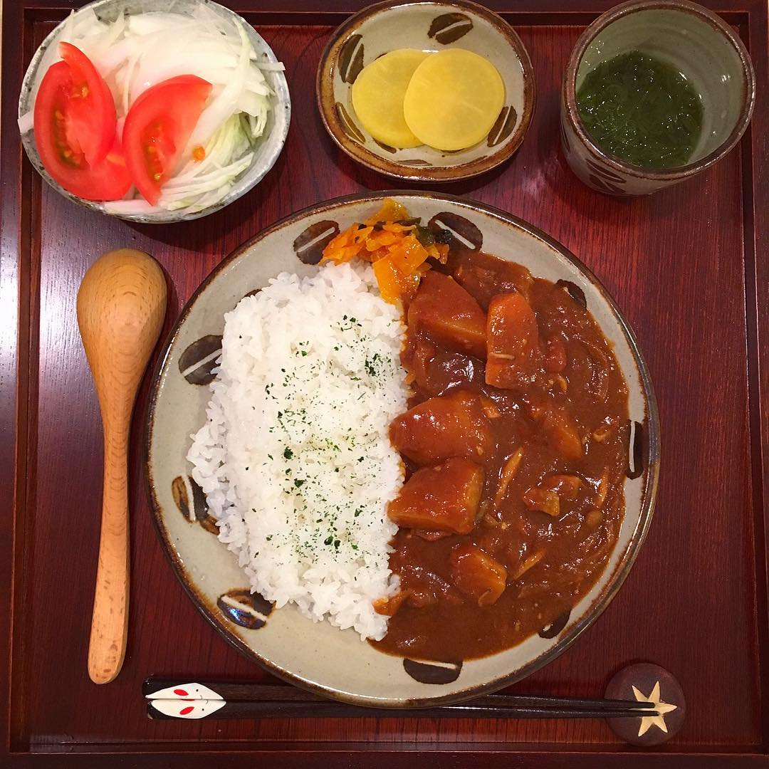
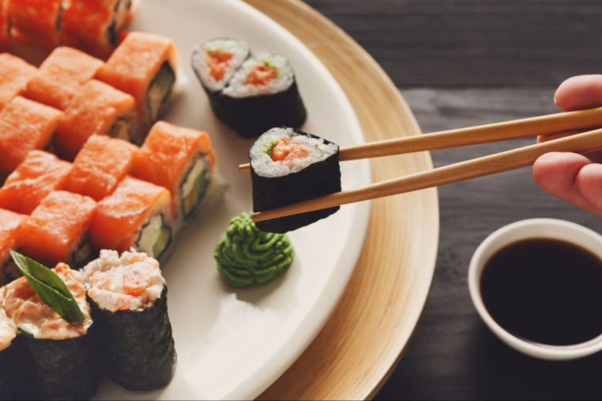
Passion
- Food: my father is the main cook in the family. He mostly did it because he had to but I grew up with his delicious dishes, his trials and errors until he got it right, and how he made us feel around sharing meals. My biggest laughs, and best memories with my father were when we gathered around what he cooked. This made me love food, the different spices and identities of food depending on the countries makes it all the more special. You never get bored with food, there is so much to explore. My father was telling a story when he cooked, his mood greatly influenced the taste of every dish. Whenever I travel, the thing I enjoy the most is eating local food, it tells me so much about the identity of the country I am in and its people. Food is a great mean to connect with other travelers as well, some of my best memories revolve around eating local dishes with travellers.

Slide 8
Purpose
I will be a successful entrepreneur, who will build a successful Fortune 500 company by the year 2026. A company that connects people around the world through the spirit of travel, helping raise the collective consciousness through the act of connecting with people from different walks of life (religion, country, traditions, culture…). I want to be the enabler for these human interactions to help break barriers and promote universal love in human species.
Why? Making a Dent in the Universe
From the beginning of times, we have always defined ourselves by the ability to overcome the impossible. We count these moments when we dare to aim higher, to break barriers to reach for the stars, to make the unknown known. We count these moments as our proudest achievements. In today’s world we have lost ourselves, or perhaps we have just forgotten that we are still pioneers and that we barely begun, and that our greatest accomplishments cannot be behind us but our destiny lies above us.

Slide 9
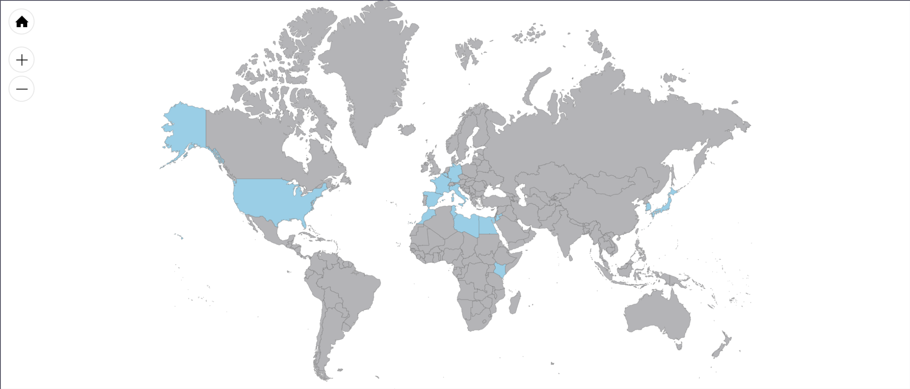
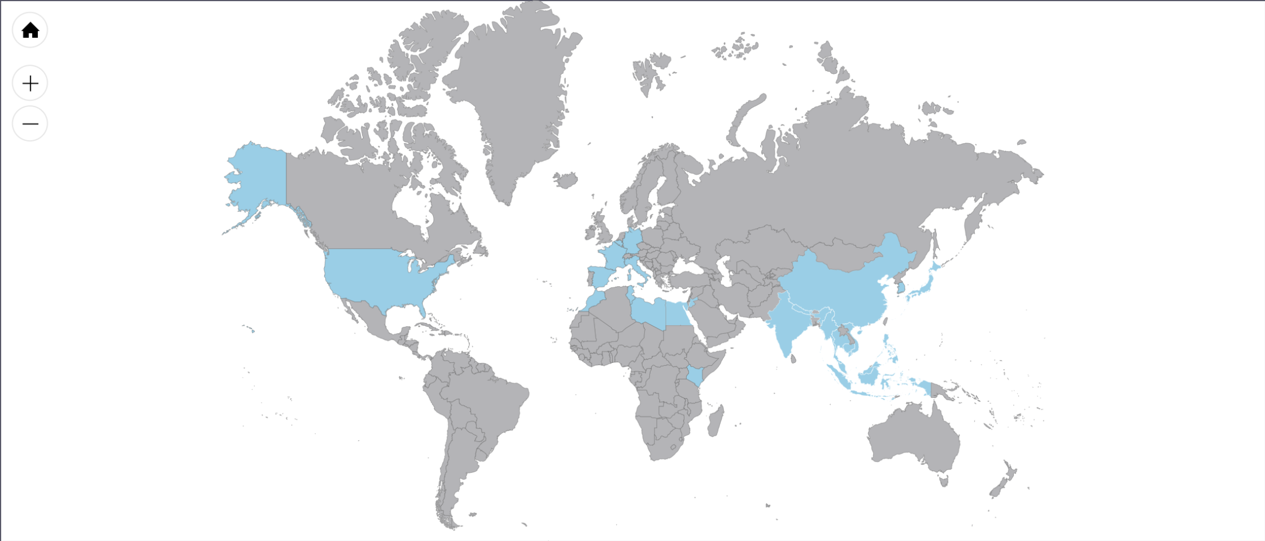
Plan
Next 2 years: (May 2020):
Benchmark of existing businesses that are direct or indirect competitors
Come up with a brand name, put together the visual identity of the brand with the help of a graphic designer (my brother)
Establish revenue goals and marketing plan
Develop website through Wordpress or Shopify, test with beta testers, review, make changes and go live with a special focus on Asian countries (help from my previous developer friends at Microsoft and travel communities).
Traffic building
Before leaving Japan, will complete a 6 month internship at SoftBank, for the sole purpose of getting connections in the startup ecosystem in Japan while working with the Acquisition department at Softbank’s headquarters (already negotiated). Done while still working on my business.
Map of Current Countries visited:
Map of countries visited by 2020:

Slide 10
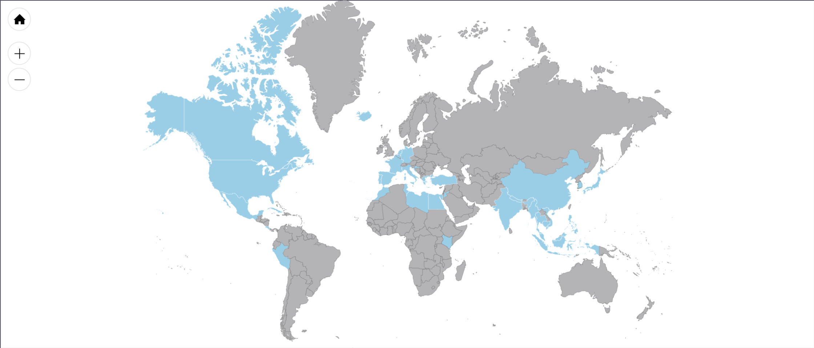
Plan
By May 2023:
Building upon traffic to create an increasing trend of new leads to the business
Expand to South America, and Europe.
Perfecting and adding more offerings
Overall goal of this phase is to increase statistics over time.
The hunt for investors begins
Start the expansion of the team
Map of countries visited by 2023:

Slide 11
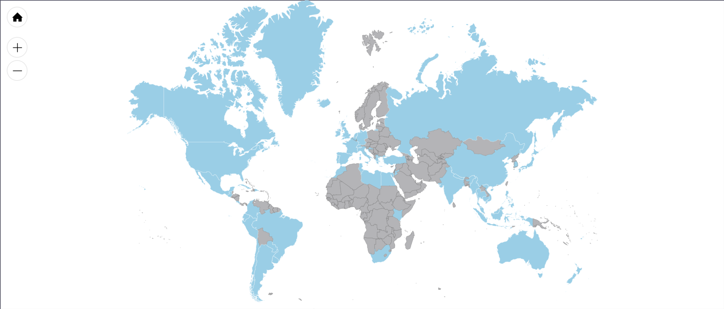
Plan
By May 2026: Expansion
Target the rest of the world
Opening headquarter offices
Expanding the team
Building on traffic to increase statistics
Process automation
→ This phase will greatly depend on what was achieved in the two previous stages to determine if things need to be added for the plan by May 2026.
Map of countries visited by 2026:

Slide 12
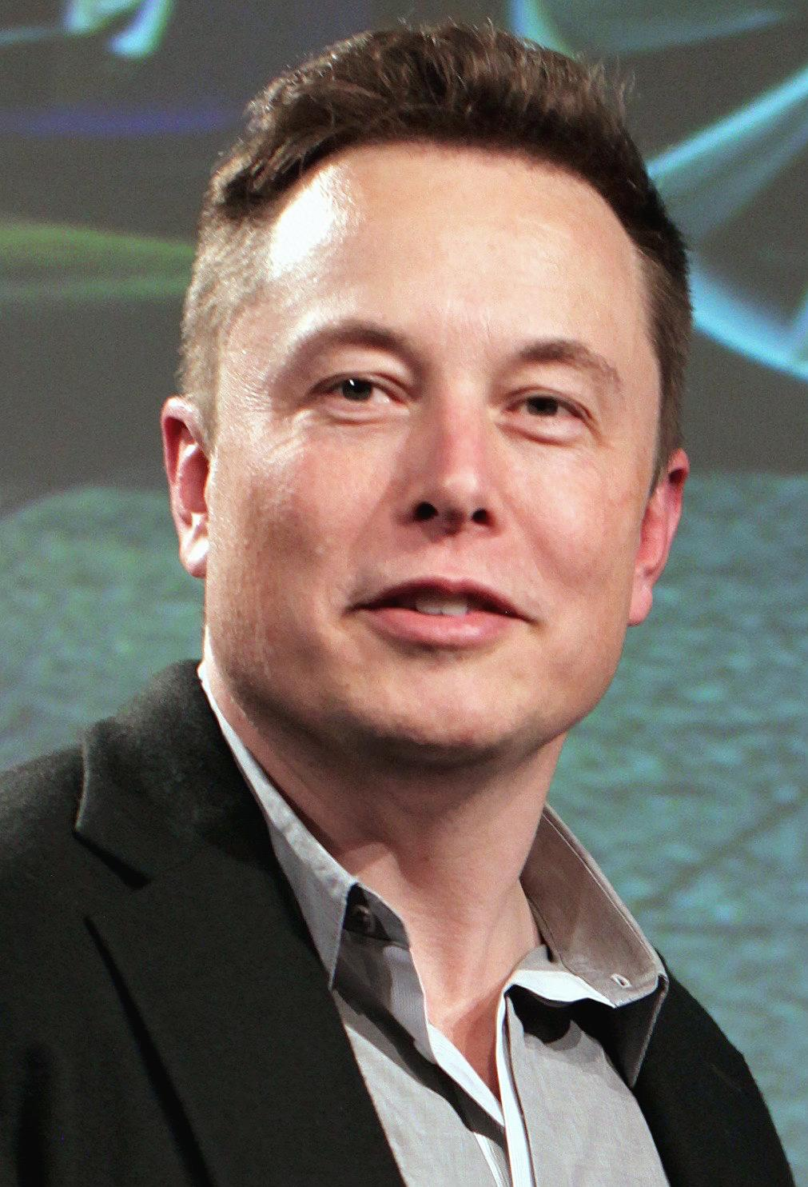
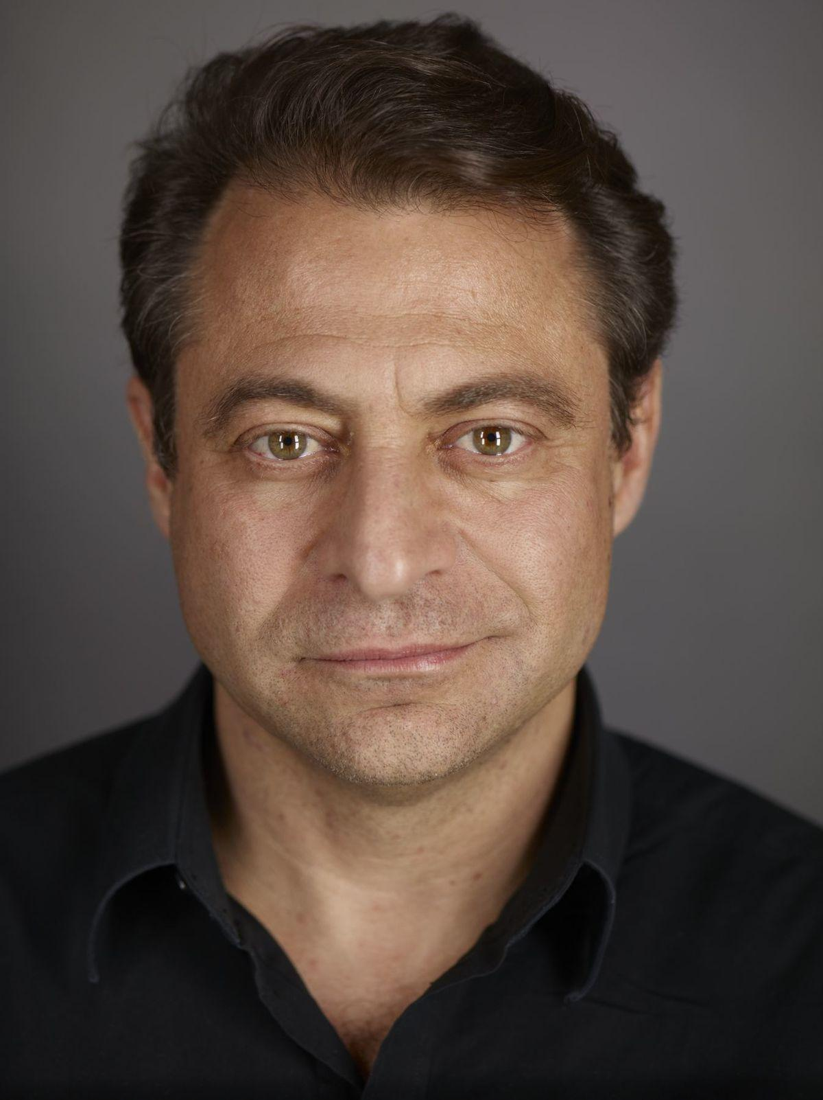
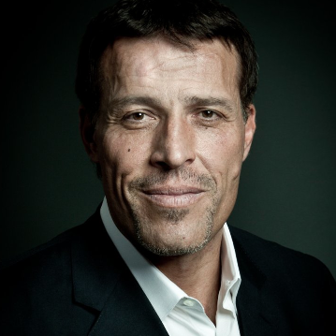
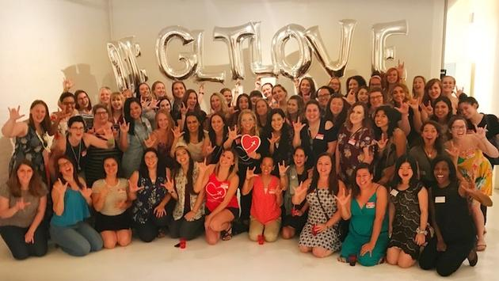
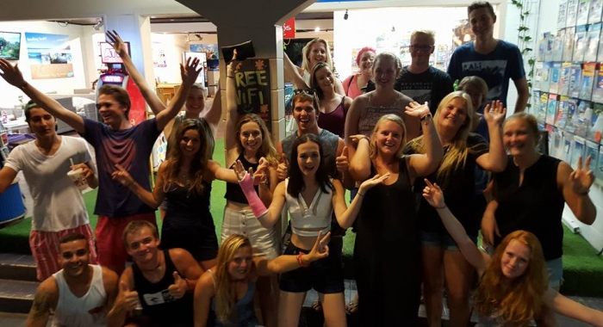
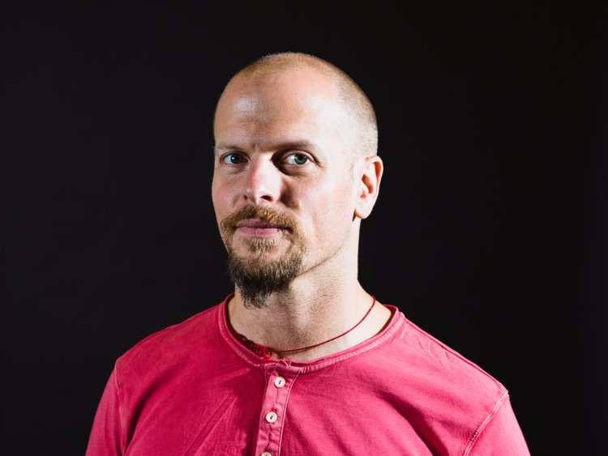
Partners
People who inspire me:
Elon Musk, Entrepreneur, engineer, and investor
Peter Diamandis, engineer, physician and entrepreneur
Tony Robbins, Life coach and entrepreneur
Online Community of
564 184 women travellers which I am part of.
Community of Backpackers in Asia of 93 377 men and women members which I am part of.
- The 4 people listed above are people who dared to aim higher and challenged the process and the system on so many levels.
- Both of these communities represent the future users of the platform that I will be launching. These are communities that I have witnessed grow and where I can closely observe the evolution of the travel experience in different parts of the world for a lot of people.
- Through the platform, they will enjoy a more meaningful travel experience and connect with locals on a deeper level, making their travels all the more memorable.
Tim Ferriss, author and entrepreneur
- I follow them for guidance in my entrepreneurial journey, and to keep up with what is happening in the industries I am interested in. Through their teachings I will pass it forward therefore enlarge their scope of impacted people.

Slide 13
Persistence
I close my eyes and see where I want to be: this is hard to understand but this is the number one thing I do whenever I feel like I am losing hope or about to give up, it is called visualization of a specific me in the future if I accomplish what I want to accomplish in life. This works like nothing else can work for me. Describing what I see is a bit personal and something I would rather keep private, but it is my personal booster that has helped me go through the most difficult times of my life.
Morning priming: this is a method developed by life coach, Tony Robbins to help maintain energy and focus throughout the day. I do it every morning to start off the day on a good vibrational level, to stay focused, and alert.
Keeping up with the industry: and that is by being strongly connected to the community I am serving, and respond to them accordingly.
Work everyday on my life purpose: work at least 3 hours per day or more depending on the day on the development of my startup. Dedicate at least 30 minutes to my online business on extremely busy days or on days when I feel demotivated. The thing is to never have a day where I am not working on it directly or indirectly.

Slide 14
"What you seek is seeking you."
-Rumi
I will start a successful business to connect humans all over the planet around the spirit of travel. I have always gotten what I wanted in life, my vision, persistence, hard work, and visualization have always helped me obtain whatever I wanted.
Nothing is impossible wherever someone stands in life, I don't only advocate this, I live it every day. Whenever I put my heart into something, all the universe conspires to help me get it. I know myself, I have never given up even when I went through difficult situations many people would not tolerate. It is my vision that keeps me going through the hardest times and that has never betrayed me.
As you can see I didn't come up with a series of purposes to choose from. I have gone through my share of trials and errors. At the age of 26 it has never been clearer to me that I was made to start my own business, not because it is cool to be an entrepreneur nowadays, but because this is my calling and it took 26 years for me to finally get it.
Even though I thought I would get it from working for others, I now know that only I can create my own vision. I am not alone, I am well guided and protected. It doesn't have to be hard, but even if it is I will do it because building this business is something I think of every day, multiple times during the day from the day I had the idea. Everything clicks so seamlessly, nothing has ever been clearer.
There is really no going back for me, there is no other way, I found my way and it is up to me to find the courage to walk my own path. A courage that has been building up inside me since the moment I came back to this planet.

