Slide 1
BRETAGNOLLE
Pierre-Emmanuel
6’s P of Life.
MBA Essentials
April 2018

Slide 2
Summary
01. PASSIONS
02. PURPOSE
03. PLANS
05. PHILOSOPHY
06. PERSISTENCE
04. PARTNERS

Slide 3
Passions (1/3)
“WILD WEEK” WITH FRIENDS
Each year with my friends, we are trying to do a “wild week”, camping in the Cevennes, a little mountainous regions in South of France, and that’s the time of the year where I feel the more passionate : Sharing, partying, talking with my friends who have a lot of different backgrounds (Economy, Psychology, Literature, Science…) and origins (mostly Europe). It’s a week where we live the “wild” way, without watching the hour, learning a lot of news things and sleeping under the stars or eating around a fire camp. It’s kind of a challenging week too because we try to enjoy our time with the least comfort possible (no bed, no electricity, no bathroom, …) , and always try to invite new people to this “wild week”. The one after my best friend’s cancer remission was the most interesting one, because I learnt a lot about myself and what really means to me.

Slide 4
Travel
I want to discover new countries and people, to get a real cultural enrichment by sharing and acting with different spirits.
01
Passions (2/3)
Learn new things
I love to learn and to have a better understanding of the world or of myself. I try to learn new things everyday, and I’m very curious about anything.
02
Friends
More than a passion, my friends really are a big part of my life : They inspire me and I just love enjoying a beer or two with them.
03
Digital and New technologies
The major reason of why I will work in Aeronautics: I need innovation and creativity to be part of my everyday life.
04

Slide 5
Passions (3/3)
Travel
Friends
When I was young, I was diagnosed with 2 years advance in mental age, and one year of emotional lateness. Because of that, I never felt really in my place at school and I wanted to discover new things, new cultures, new people. And I’m very lucky because my parents let me go one month to New-Caledonia in a pen pal’s family when I was 11, then, a whole year in a family in California. I also had the occasion to discover Japan when I was younger, and I fell in love with this country where everything is “different”. I still want to discover the world nowadays, with my girlfriend by my sides.
At the end of my High School, I had a big change in my life : I, a villager guy who used to live with his mother, sister and brother in a Villa far from every cities, had to move alone to Montpellier while my family was moving to Dubai. There, I met someone who helped me in bad times for no reason at all, and who became my first real friend : I then quickly realized that the place that I was looking for when I was younger was in fact in the heart of my friends and people I love, so, from a lonely boy, I became really social and fully dedicated to other people and made a lot of good friends, that I consider as my second family. The good thing is I’m never disappointed by the ones I love because I’m not expecting anything from them.
Learn new things
Digital and New Technologies
At the age of 12, my family and I lost everything that we had in a very quick but powerful flood : House, toys, papers, … So I had to live in my grandparents house for 1 year with nothing to do but reading books and playing with my dog. I discover new universes even larger than Planet Earth in the amazing stories of Victor Hugo, Hemingway, Voltaire… and started to enjoy learning new things, mostly by myself, in a lot of different domains (Science, History, Literature, …). From this day, I started to enjoy intellectual challenges and understanding the world of today, which is mostly why I decided to study Economy and Business, with no real attach for materialistic things.
My first encounter with new technologies and digital was through Software and Hardware Computer gaming. By building my owns computers, and creating a lot of digital content (Vloging, video and picture editing, websites creation, …). Because I have a very creative mind, I found a way through new technologies to express myself and to realize my ideas. My work experiences are all about New Technologies, and I will surely work in an very innovative field later.

Slide 6
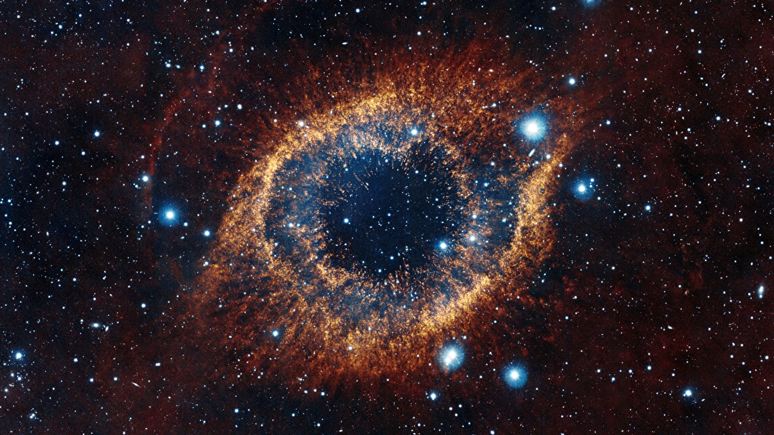
Purpose (1/2)
ONE PURPOSE :
CREATE AND LEAD A USEFUL DIGITAL FIRM
CREATIVITY. UTILITY. CHALLENGE. 15 years
A continual challenge, leaded by efficiency and utility. The ship I want to sail, making the world a better place and help me to make the one I love happy.
Such a purpose is very time consuming, but there is no wasted time when you work for your passions. The value of this digital firm will be based on universal utility through universal principles : Confidence, Love, Friendship…

Slide 7
Many different goals…
Other purposes that I decided not to choose because they all converge towards my “ultimate” purpose.
Purpose (2/2)
MAKE THE ONE I LOVE HAPPY
HAVING THE TIME, NOT THE HOUR
Protect the people I love and try to enjoy the major part of my time with them : Laugh, share and live exciting new experiences with them . I’m also someone who loves to meet new people so my goal is also to make the world a happier place.
Having enough time to do whatever I want and not be worried about the hour, I’m a hard worker but I think that you can spend too much time on useless things and miss your life, you have to live the present and to not regret anything. Get out of the routine, my worst fear.
BE AT THE HELM OF MY OWN SHIP
ALWAYS FIND NEW CHALLENGES
Figuratively, build something with “my crew” and drive it through storms and nice weathers. If I say ship, it’s because if I create something, I hope it will help me discover new aspects of my life and of the world (It could also be a spaceship because one of my dream is to try zero gravity experience).
In my opinion, someone who tries all his life to be better than the others will always be sad, because there will always be someone better than you on a specific point. The important thing to keep in mind is : you have to give the best of yourself. That’s why I am always trying to find new challenges where I have to give my best to find new solutions, new opportunities, and that’s also why I never get bored : I call that a “luxe”.

Slide 8
Being inspired by Japan
Learn new things
Plan as much trip as possible with my new friends to discover Japan, meet new people, enjoy the Japanese culture and try to see
some issues from a different angle to find inspiration.
Try to give my best at school every week to learn new things and try to enjoy my free time to learn how to speak Japanese by myself.
Use leadership and strategic thinking
to precise my
Where I am now / Where I want to go / How
1
month
Improve my Digital skills
Plans (1/2)
Write new articles for my digital blog (toiledefond.net).
Keep myself informed about new innovations in the 2.0 world.
Begin to learn a new programming language and try to develop a new website for my multimedia association (Hotsoft).
Share new knowledge with the ones I love
Call them monthly at least to see if I can help them and share with them.
Share my new knowledges with my partners and see their point of view on my purpose, goals and idea.

Slide 9
Discover new promising lands
Find my first job in Aeronautics
I want to discover a new continent and new cultures.
I will have to find enough free time to explore Africa (my last continent to visit) with my girlfriend.
I strongly believe that some countries in Africa can become the next digital giant and want to analyse with my own eyes the possibilities to develop new products for this typical market. I will also complete my vision about what is “being global” and enhance my global spirit, which is important if I want to globalize my future firm
Develop my career and find a job connected to aeronautics and technologies to work in a field related to my passions after my Master 2.
Be happy at work and be sure that this work will help myself to reach my purpose by acquiring new key resources.
Plans (2/2)
1
year
Have a more precise vision about my future firm
Find issues I want to solve.
Find innovative way to solve them.
Write solutions that come to my mind every week.
Ask myself about the utility I want to give to my purpose and firm and from their, write my first BPO and send it to my school start-up incubator.

Slide 10
PARTNERS (1/2)
Achievement in life
Happiness through challenge
Because I see my purpose as a ship that my “crew” and I will have to sail through storms and good weathers, I think that we will benefit from a huge feeling of achievement in life and love for each others if we succeed.
I am a very sincere person who can sometimes hurt people through my outspokenness. But I also know how to motivate my partners to undertake a challenge and to be happy to do so.
Time and money
Experience and new knowledge
Creating and managing a firm requires a lot of time, and sometimes money too. But when I will achieve my purpose, as I am not materialist, I’m willing to share my free-time and money with my partners.
As I love to learn, I also love to teach and share knowledges with my partners.
I also hope that through this challenge, they will learn a lot about themselves.
BENEFITS FOR MY PARTNERS

Slide 11
PARTNERS (2/2)
I see all my partners as potential associates of my future firm because I trust them and I know their abilities and where they can give the best of themselves.
My girlfriend
She had a huge impact in my life and is my motivation motor. She gives a real meaning to what I want to do, and reignites my passions. She has a business and financial background too, and is passionate about entrepreneurship and Arts, because she thinks in a real different way than I do, she will be a meaningful and useful partner to my purpose.
My friends
Because they always speak frankly with me and I fully trust them, and because we have very different knowledges and thinking, they will be my pillars in life and in my purpose. A lot of them also have also different backgrounds (Business, Economics, Programming, Sociology, Psychology, …) and live all around the world, they have already welcomed me in Tokyo, Paris, London, Barcelona, … I strongly believe they will want to help me in my purpose and, for some of them, to join my “crew” on the “ship” I want to build.
My family
My father is CEO in Aeronautics, my mother is the most dedicated and kind person I know, my brother is a professional rugby man with heart on his sleeve and my little sister a very smart future lawyer. But if I want them as partners, it’s not for who they are, but for what they taught me: fighting spirit, fraternity and courage. My family spirit and values will help me achieve my purpose.

Slide 12
PHILOSOPHY (1/2)
I chose a space themed PowerPoint because it represents the paradox of my nature : When you see a star, you can think that’s a beautiful symbol of hope and dream that you have to follow, but you can also think it’s an astronomical object consisting of a luminous spheroid of plasma held together by its own gravity.
My friends call me a “Realistic Dreamer” because I usually think in a first time as a realistic person and then try to find new creative meanings to things.
01.

Slide 13
PHILOSOPHY (2/2)
02.
During a long time, I thought that I had to live without any purpose, because life is absurd : We are just dust compared to the universe, and will go back to dust.
03.
Then, I met my girlfriend who went through really hard times during her life but succeed by herself anyway and kept the will to live and to discover the world. She has much ambition where I used to have no ambition at all, so she gives my life a new meaning about helping her to achieve her ambitions.
She impressed me so much that I realised : Even though we, as humans, mean nothing compared to the infinity of the universe, the ones we love have a concrete universal meaning.
If today people define me as a realistic dreamer, it’s because I’m very realist and down to earth, even though I always believe in myself, always get what I really want and encourage people to believe in themselves, but I keep a “dreamer” mind by being very creative and by always finding new ways to relativize when bad things happen.
04.
My purpose is strongly linked to my philosophy cause it’s the meaning I want to give to my firm :
Utility through universal principles (Love, Confidence, Friendship, …).

Slide 14
PERSISTENCE (1/2)
What if I feel like quitting?
Things I would tell myself :
.My father, CEO, was always travelling for his work, and didn’t have much time to teach me much about business, but he learned me important things: You must never feel down, you have to keep going and to relativize about bad things and live the present moment. .Keep looking for new challenges and always see opportunities trough failures.
.Don’t try to be the best, but always be sure to give you best and never fear the look of the others, be confident and not afraid to “jump” to never regret anything.
.Always believe in yourself and stay humble, believe in the others too.

Slide 15
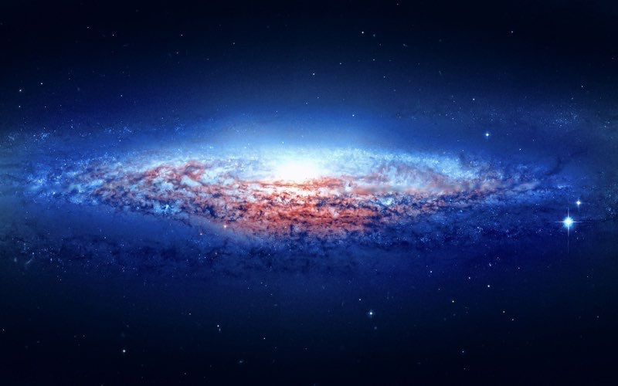
How to keep being motivated about my purpose ?
PERSISTENCE (2/2)
Every year, check my progress on my purpose and goals. If I’m not satisfied, ask myself why and readjust my plans and behaviors.
Every month, think about important things that happened in my life and think about why it helped me to have a better understanding of the world, the others or myself.
Every week, write down issues that I or friend had and try to find new solutions to efficiently resolve those issues.

Slide 16
I WILL ACHIEVE MY PURPOSE
I wanted to add a P about my philosophy because I think it’s essential to understand why I want to achieve my purpose and the meaning it has to me. I’m not dreaming about a universal Love, but I strongly believe that my purpose will be a way for people to have more confidence in themselves and to make life easier for people so they can take more time to take care of their loved ones. It will also be my own way to challenge myself and reach my goals. My values, career, experiences, partners taught me to always be self confident and go forward. And thus, I never fail in life, because I always believe in myself (and my partners are impressed about how strong my will is) : I have many example in life where people thought I wasn’t able to do something and I prove them the opposite (teachers telling me to quit school but in the end of the year I was the Major for example)., and where people see failures, I see opportunities (it’s what I call relativism). My will can be sometimes perceived as pride, but I’m always questioning myself and the things that surround me, and try to learn from others while staying humble, I think that everybody has something interesting to teach.
My passions and goals are all about discovering and caring, and they all gather to the same point which is my purpose, and I know I will be able, helped by my plans and partners, to build a useful digital firm.
"Everyone knew it was impossible.
Then came an idiot that didn't know and did it.“
Marcel Pagnol

