Slide 1
5P of life Veronika Dávidová
„I want to become a specialist in marketing, communication, and PR and teach it at the university.“

Slide 2
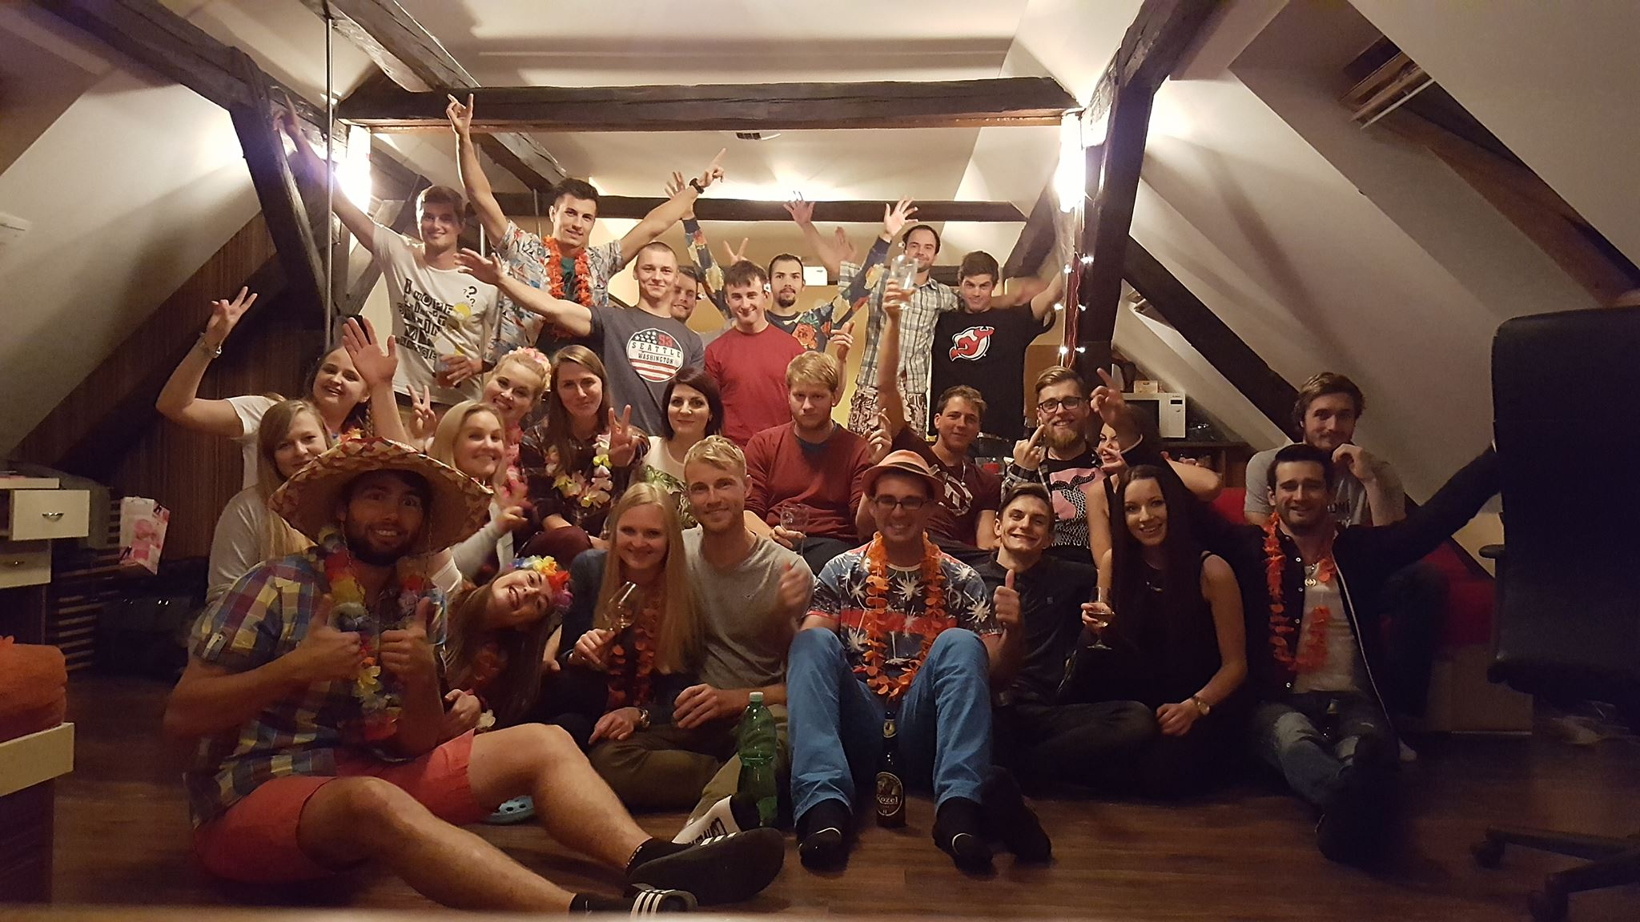
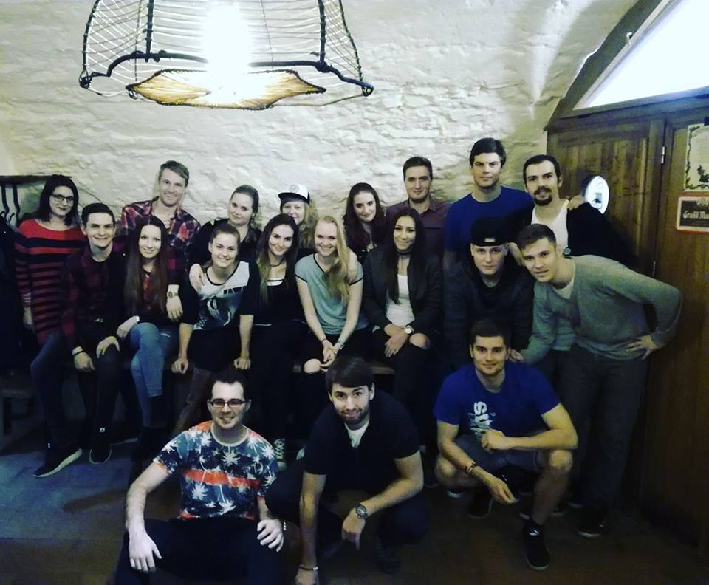
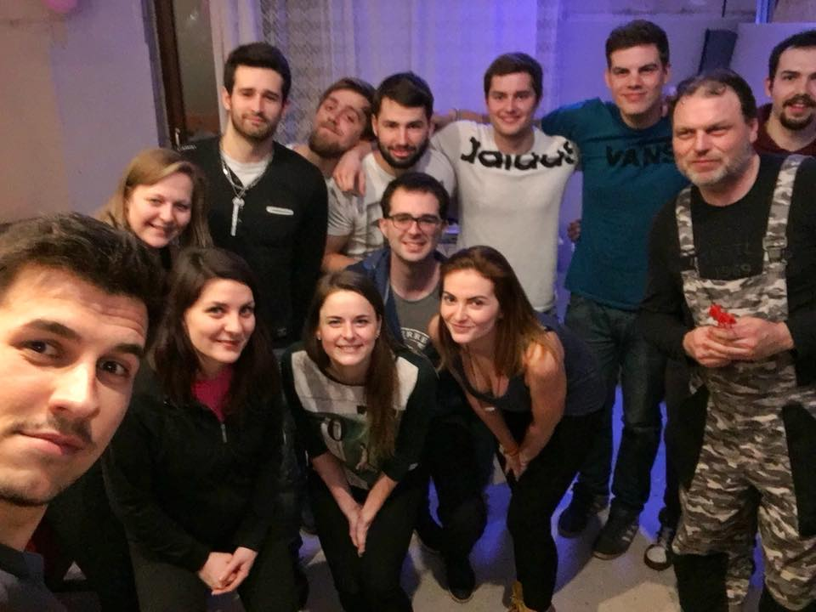
PASSION
When I was diagnosed with multiple sclerosis I knew that it will change my life. But I have always been a fighter so I decided to prove that I am stronger than illness and that my mind can defeat it. I started with the healthy lifestyle I was more focus on school, work, volunteering, my family and friends and I did everything on 120%. I was more successful than ever before. My friends noticed the change and they were surprised where the energy came from. They didn´t know about my disease. After 5 months I decided to tell them about it. They were surprised and sad but they also told me that in last few months I did as much work as none of them. They told me that I inspire them every day. I don't feel like a role model but it makes me happy and full of passion when I or my story improves someone's life.

Slide 3
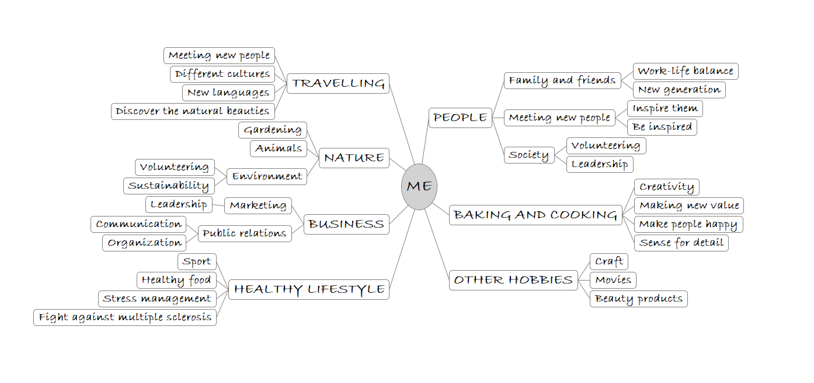

Slide 4
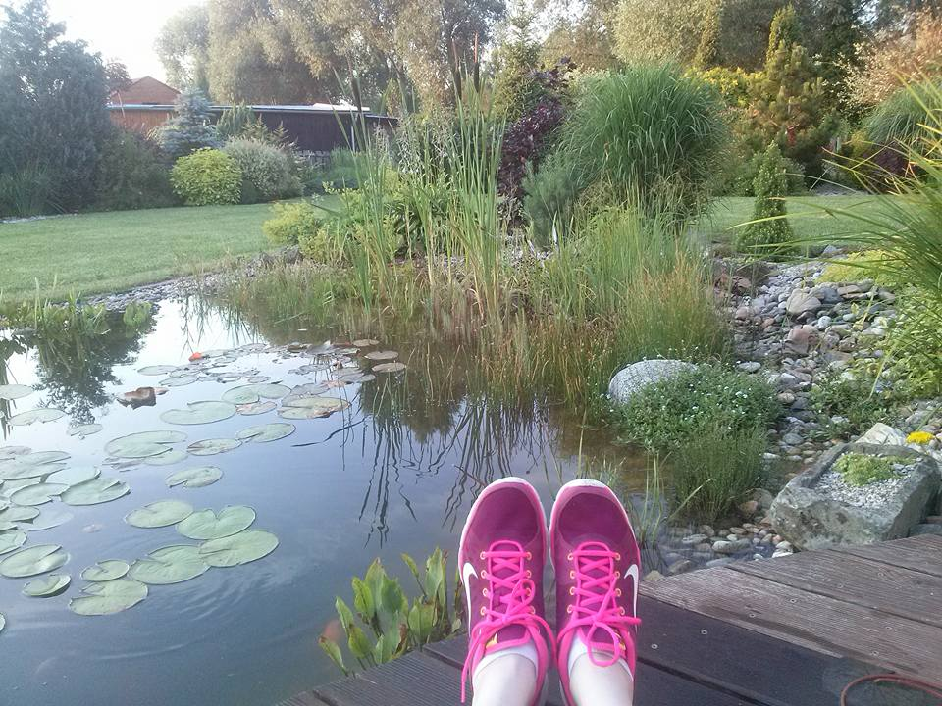
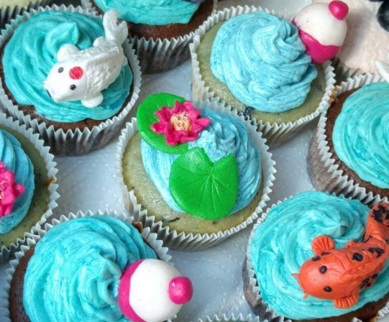
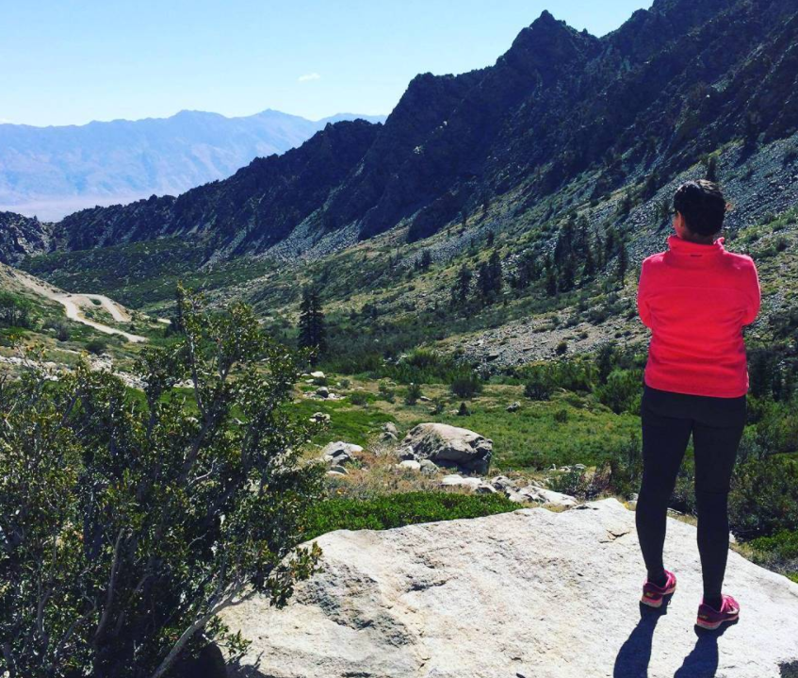
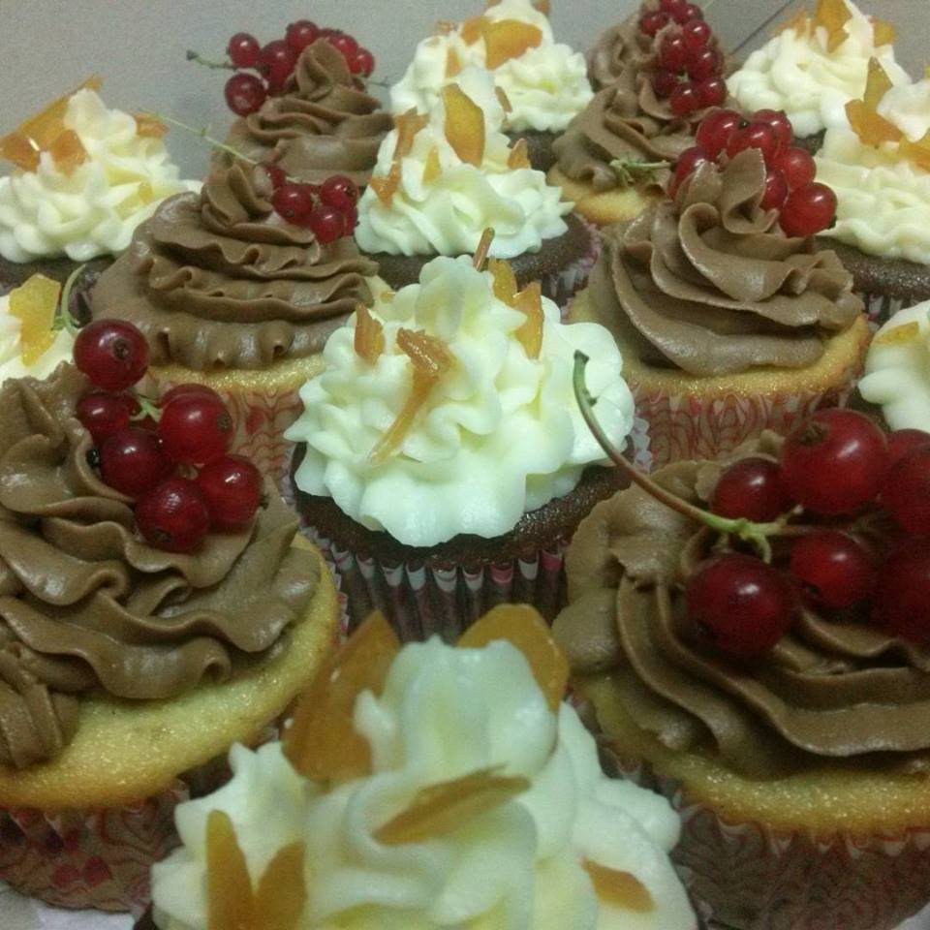
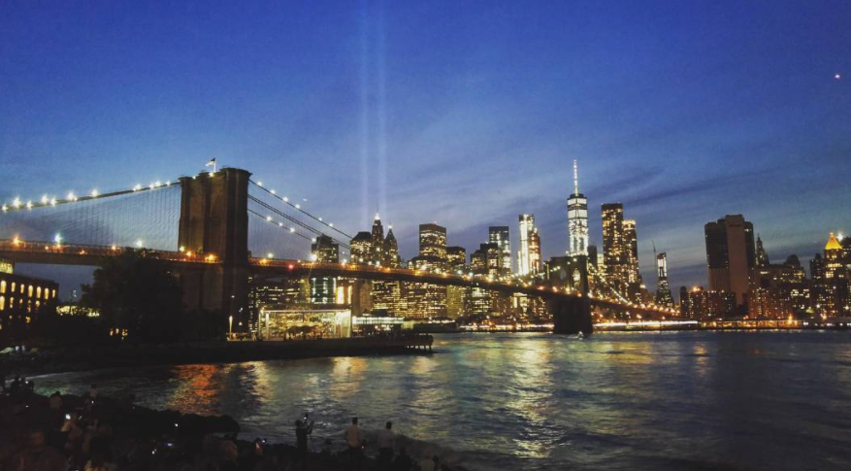
I love communication with people because I know that we can inspire each other
I feel how important are the people around us and I love to cooperate with them or lead them to better results
PR and marketing are for me the way how to pass on my creativity and fresh ideas to people
Planet Earth is just one and we have to look after it because we live thanks to it
I feel a strong association with a society and I knew that together we do whatever we want
I am passionate about new opportunities, places, ideas, and people
I love nature and that calm which it brings
If you are investing into the flower it will always pays you of

Slide 5
Values
Positivity
Adventurousness
Diversity
Growth
Altruism
Expressiveness
Fluency
Making a diference
Creativity
Thankfulness
Family-orientedness
Goodness
Community
Balance
Originality
Carefulness

Slide 6
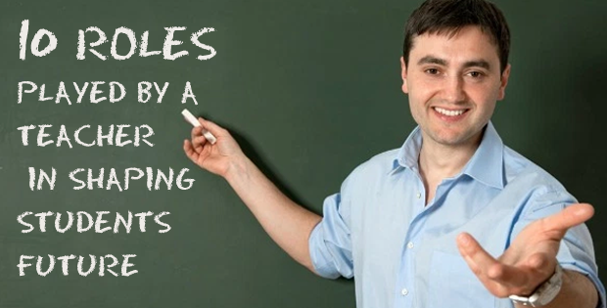
PURPOSE
I want to become a specialist in marketing, communication, and PR and teach it at the university.
I love to inspire people and people inspire me
I want to be helpful for society and this can be way how to influence new generation
I want to travel the world, discover other cultures and share these experiences
Communication is my passion and it is something that teachers do every day
To become marketing specialist means to gain experience from different companies and it will be a part of my plan
As a teacher, you can share your knowledge, experiences and values and encourage people to live passionate lives
There is also a place for research and writing books
In my opinion every teacher needs background to be respected

Slide 7
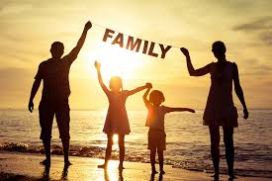
PURPOSE
Rejected purposes
To write a book about challenges of life and how to deal with them
I don´t have enough experience but I want to encourage people to fight against destiny and to challenge yourself. There is also opportunity to achieve this goal during the way to main purpose. I put it there as a part of my plan.
To become CEO of an international company
I like management and leading people but to be CEO is very difficult and stressful. It takes a lot of time and I want to have enough time for my family. I am also more specialized in marketing and PR and I want to go really into deep of this problematics.
To become full-time mother and housewife
I know the importance of the family but I think that it is possible to be a good mother and a marketing manager at the same time. Family is one of my values and it is part of me so I don´t need to make a purpose from it.
To start my own business
I don´t have enough experience or a good idea to start my own business. I hope that it will change during my professional carrier and I will be able to come up the idea or whole business model. Thanks to Japan I met a lot of new people from diverse industries and I will that I will benefit from this in the future.

Slide 8
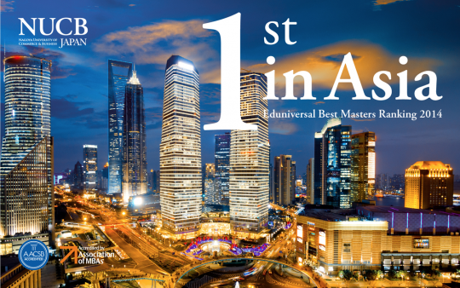
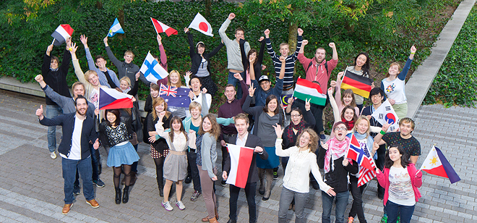
PLAN
NEXT MONTH
Successfully and with a good grades pass NUCB classes
I see this as opportunity to meet new people with different point of view. They can inspire me and stimulate my critical thinking. After first courses I feel that I am still thinking in the box but it is not enough. During the lessons I want to unlock my potential. I am trying to participate as much as possible. Go deeper into the case studies and all assignments.
Improve my language skills with an everyday short grammar lesson
I feel that there is a space to improvement. As a teacher my English and grammar have to be perfect. I want to join prestige English speaking universities as a teacher. This is the reason why excellence in English is one of my long-term goals. Now here in Japan I have unique opportunity to speak.
To communicate more with other students and share their experiences
I can also improve my contact network. It can bee very helpful in the future and some of the people here can become my Partners. I already met a lot of people with interesting jobs or life experience. I am full of new impression and I have to think about them.
To finish my thesis (theoretical part)
I already started but I still miss 15 pages. I can use library at the school. I found some people who also need to work on their thesis so we can support each other. They will be my partners for this goal. Both sides will be benefit from that kind of partnership.
To apply for a digital communication course
In Prague there is very interesting semester course in digital communication. My friends recommended it to me. The teachers there are specialist from that industry and they are sharing their experiences. Also students are variety. It can helps me to get better inside into modern marketing and I can also find some new partners there.
To travel around the Japan and get inside into the culture
Traveling is one of my passion and I think that it can also helps me to extend way I think.

Slide 9
PLAN
ONE YEAR
Successfully and with a good grades pass NUCB classes
In this case the journey is the goal. I want to get as much as possible from it.
Finish my university leaving exams
It is in September but I have to stared prepare myself right after I finish in Japan
Pass digital communication course
This one semester course is every Friday and Saturday during winter semester
Expand contact network (NUCB, DIGI semester)
It means to communicate and stay in touch with these people.
Apply for doctorate studies
I want to get some work experience as well so I decided to study remotely. I will stay in touch with university but I can work as well. It will be difficult but it will helps me achieve my purpose.
Find full time job in marketing (Future Leaders Trainee programme provided by beer manufacturer, owner is Asahi group)
I want to visit Asahi during my stay in Japan. I hope that this connection can become one of the things which can helps me to get a job. I have to study everything about this company and also about the industry. I have also find interesting page with educational videos. Some of them are focused on interview. I will send my application right after I will come back home.
Start learning German
There is a lot of companies from Germany. It is our neighbor and offers lots of opportunities to carrier development.
Join OpenIDEO, Volunteering
It is part of my values to serve the society and planet. This is the way how can I do it and it can also helps me with my development.

Slide 10
Become team leader Long term plans and potencial employers
2 years
Promotion
5 yeras
10 years
Start up my own business
To become team leader (small team)
Get certificate from English (C2)
Become head of marketing department in international company
Finish doctorate studies
Work abroad
Finish MBA studies
Get certificate from German
Start to publishing (articles, books)
Start to teach at my home university

Slide 11
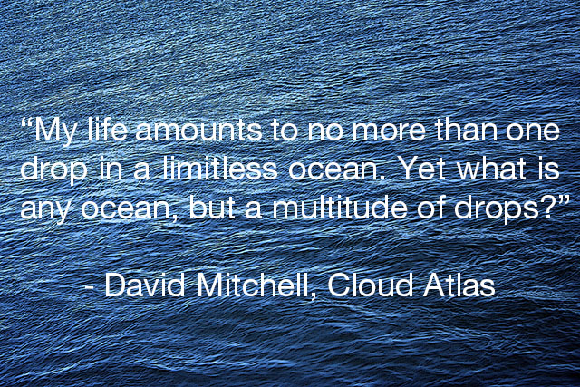
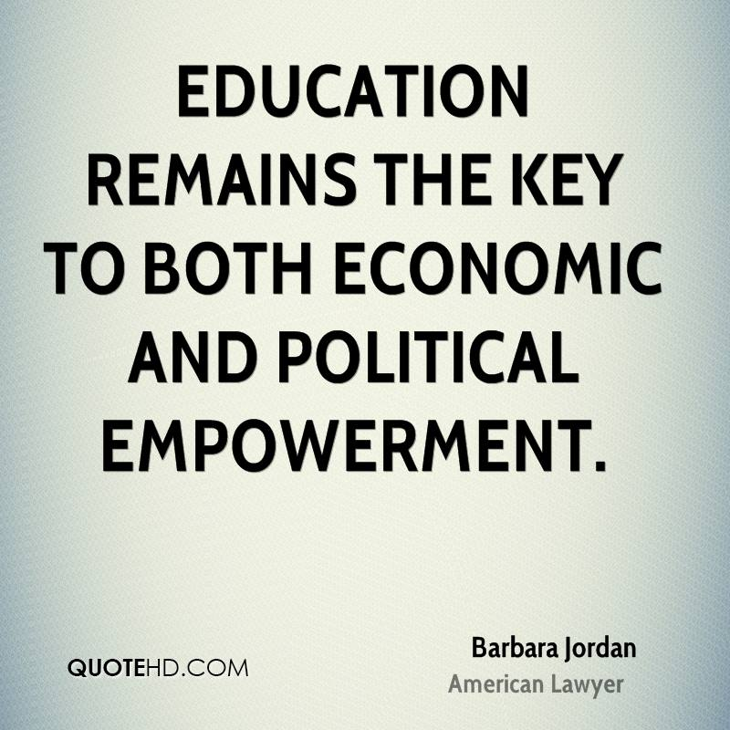
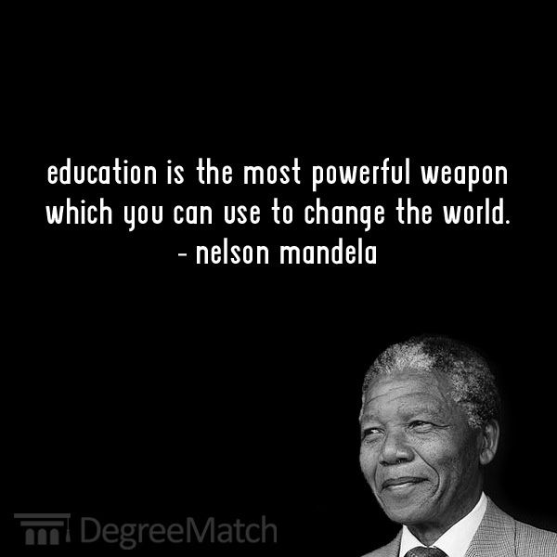
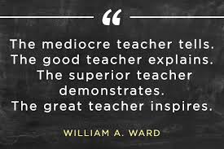
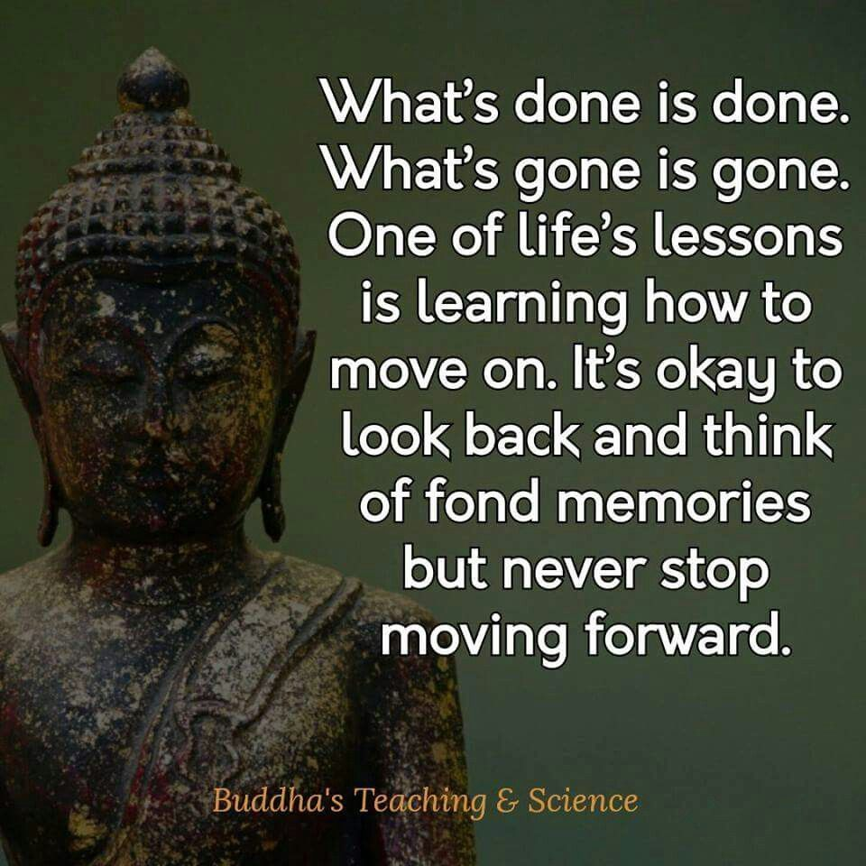
PARTNERS
Quality education helps everyone

Slide 12
PARTNERS
My Father
He was always my friend, motivator, critic and role-model. I am his only child and he always helps me. He just want to see me happy.
My family in Great Britain
My cousin lives in Manchester and her husband works in accountant company as a marketer. We already spoke about the possibility to work there for a few months or years. They are looking for new colleagues and need someone who will give them a different perspective.
My home university
They always support me as much as possible. They gave me the theoretical background, practical experience and opportunity to study abroad. We can cooperate in the future on my doctorate and research.
NUCB
Thanks to study at NUCB a get a lot of new ideas and I broaden my horizons. I hope that I will stay in touch with my classmates and teachers and we can encourage each other to achieve the purpose.
My whole family and lifelong partner are always supporting me. I know that the network of contacts is extremely important and I will také care of every relationship.

Slide 13
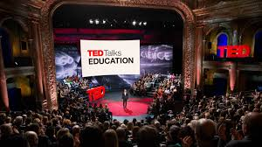
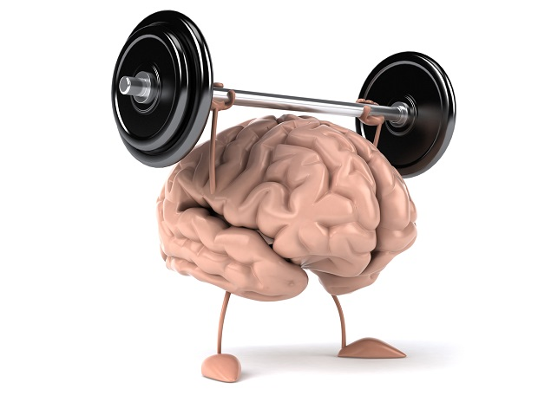
PERSISTENCE
I will print this presentation and I will put it nex to my bed. Every day when I wake up or go to bed I see it.
I will watch TED Talks to stay inspired
I will watch one educational video each day
I will talk about it regularly with my mentors (familly, teachers, friends)
I'll update the schedule every month
I will continue my healthy lifestyle to be fit

Slide 14
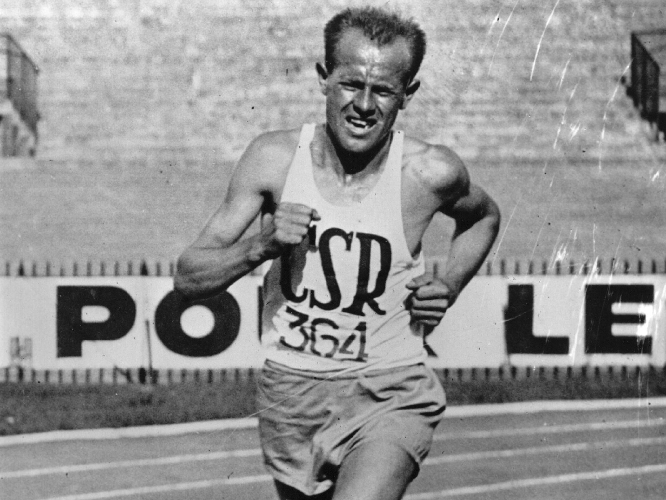
PERSISTENCE
Once I had a very bad day. I wanted to scream and quit everything. I went out of the school and suddenly I heard that Czech song from the open windows. Children's choir sang:
If you can´t more
you can add more
just shout from the full lungs
that the word impossible - doesn´t exist
the word impossible - doesn´t exist
The song is inspired by the famous Czech runner Emil Zátopek. Since that this is my number one motivation song. And it helps everytime!
https://www.youtube.com/watch?v=7De-UU9qB9Q

Slide 15
Why I will succeed?
At the very beginning I didn´t like this framework at all. I always believed that the way is more important than the goal. I was always sad after every failure even if I knew that the failures brings new opportunities. But when you explained all 5P I become less negative. I like the idea that even if you are not able to achieve your goal you are living your passions. When I was looking for one purpose it was so stressful. I was sitting in my room and I was angry and I hated that assignment. After few hours it came from nowhere. I said aloud that I want to become university teacher and suddenly I felt total peace. Somewhere inside me I knew that this is the right way. After this everything start to make sense. I was able to plan my steps and to formulate clear vision. I call home and everyone expressed me the support. I don´t know how to convince you that I will achieve my purpose. But I don´t need it. I can feel it inside and not if but when I will achieve it a will let you know. Thank you for that new perspective.

